Slide 1

Steady-State and Transient Models of Groundwater Flow and Advective Transport, Eastern Snake River Plain Aquifer, INL and Vicinity, Idaho
Jason C. Fisher, Daniel J. Ackerman,
Joseph P. Rousseau, and Gordon W. Rattray
U.S. Department of the Interior
U.S. Geological Survey
Notes:
-Today I’ll be discussing steady-state and transient models of groundwater flow and advective transport in the eastern Snake River Plain aquifer. The purpose of these models is better understand the aquifer and the movement of wastes in the aquifer resulting from the historic waste disposal practices at the Idaho National Laboratory or INL.
-Co-authors on this project include Dan Ackerman, Joe Rousseau, and Gordon Rattray.
-The models were developed by the USGS in corporation with the Department of Energy.

Slide 2
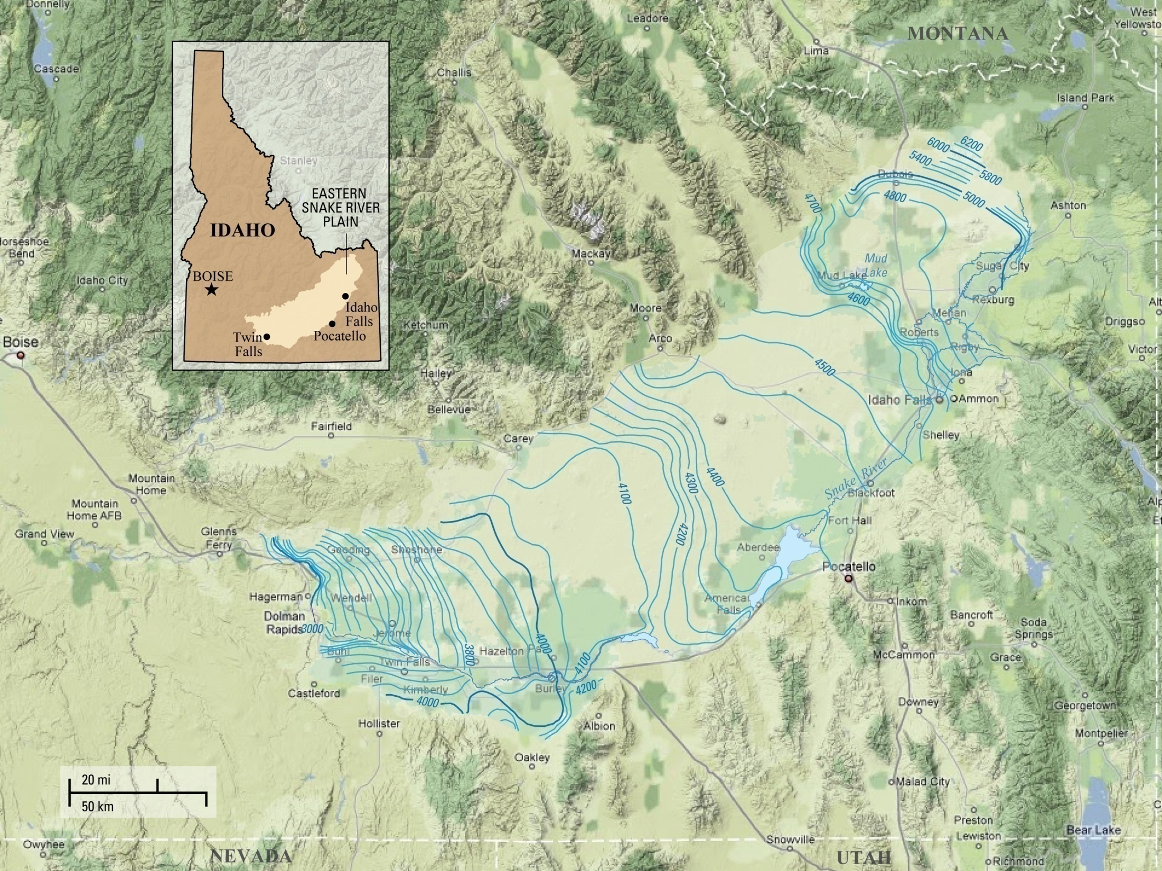
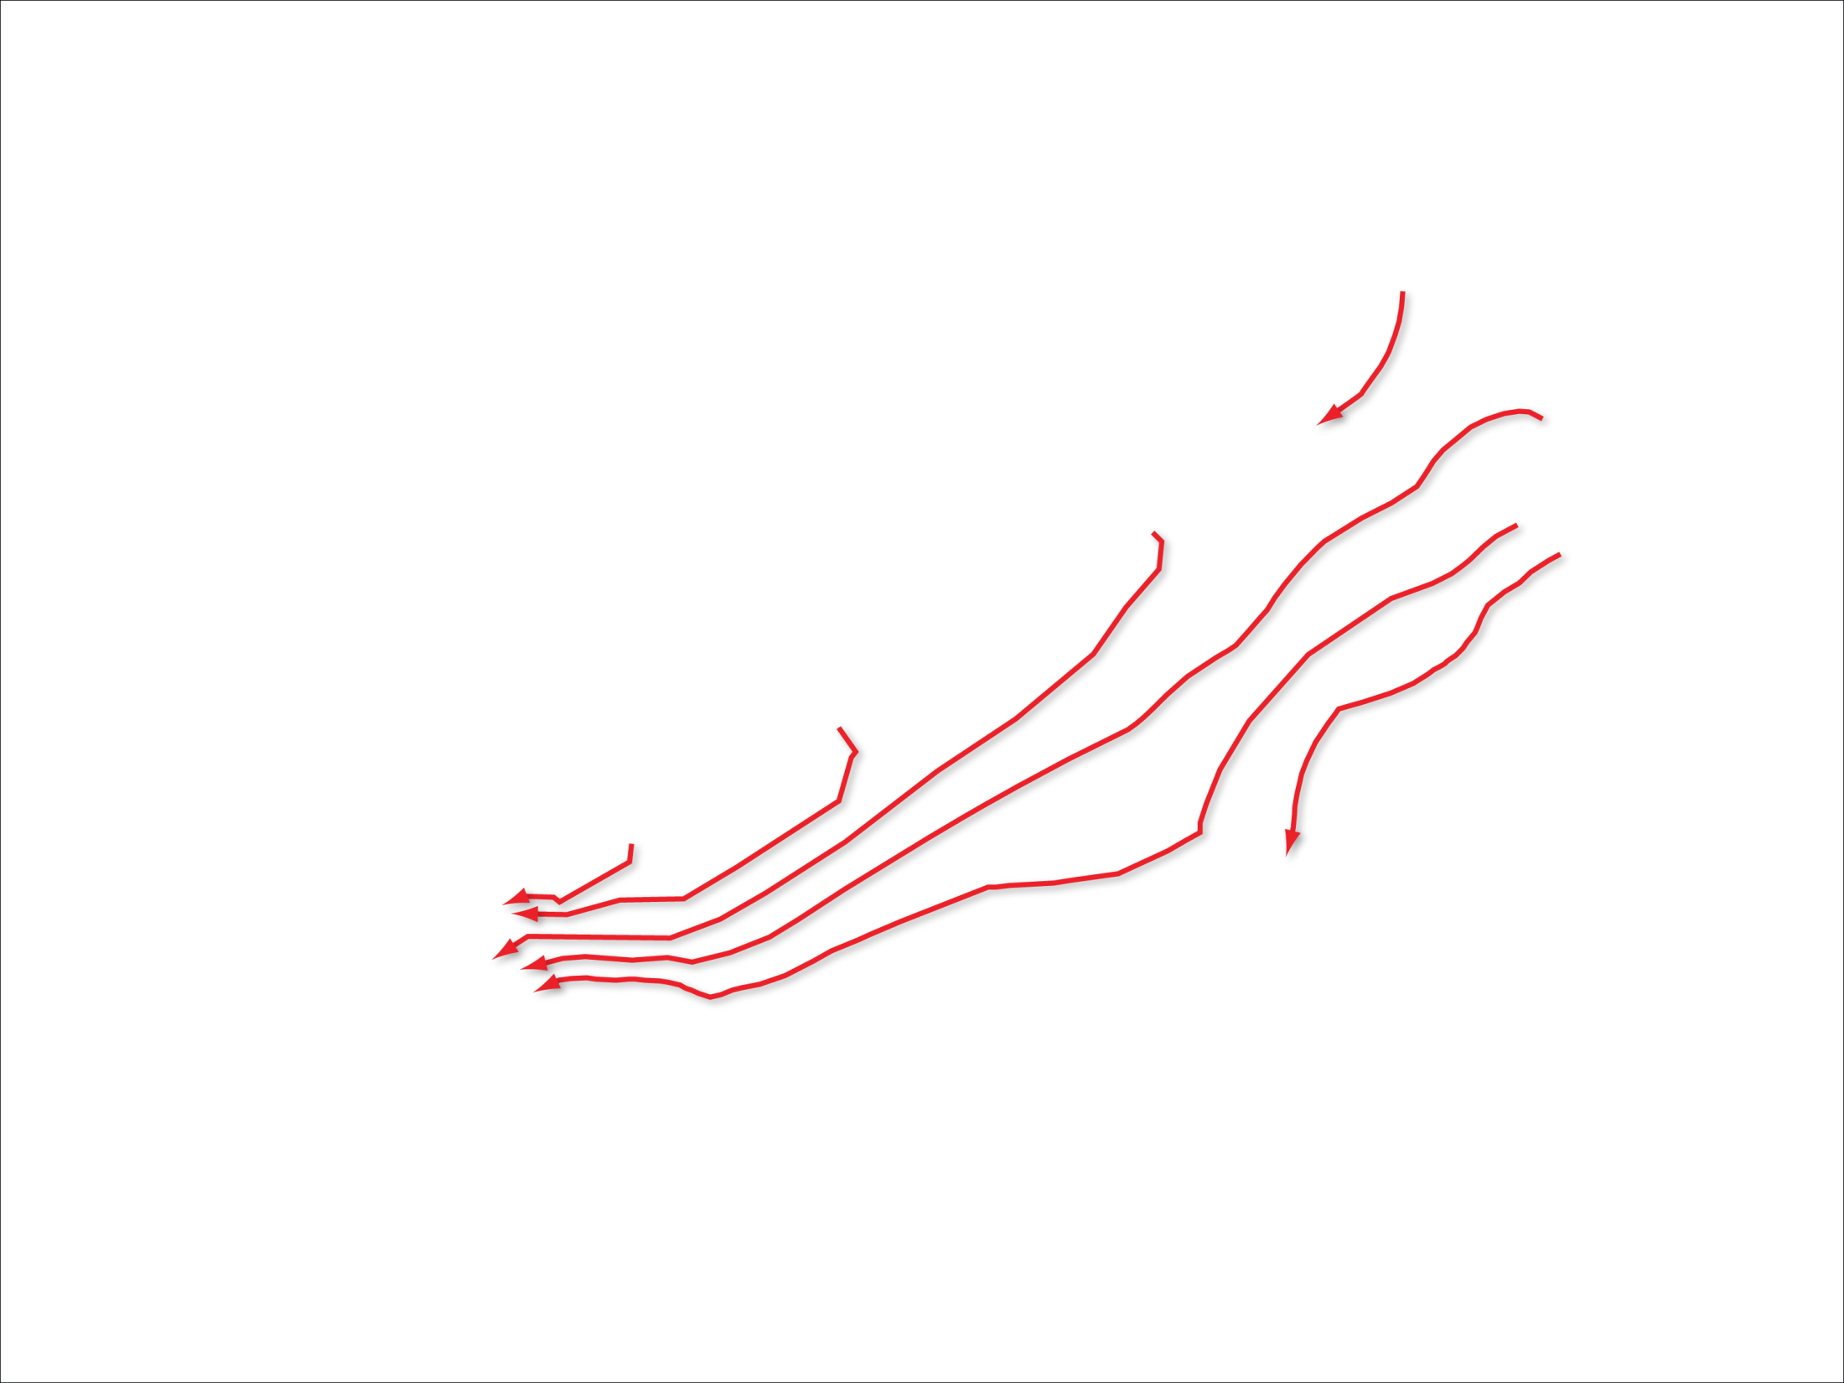
Notes:
-The area of interest is within Idaho’s eastern Snake River Plain aquifer, a relatively flat topographic depression, about 200-miles long and 50- to 70-miles wide. The aquifer is surrounded by mountains on three sides and rimmed by the Snake River near the edges of its eastern and southern boundaries and by canyons along its southwestern boundary. The aquifer is primarily composed of fractured basalts, interflow zones, and interbedded sediments.
-The 1980 water-table shown here as line contours of equal hydraulic head [[NEXT]] shows a southwest regional flow direction with groundwater moving from the Yellowstone Plateau in the northeast to the Thousand Springs area in the southwest with a total water-level drop of approximately 3200 ft.

Slide 3
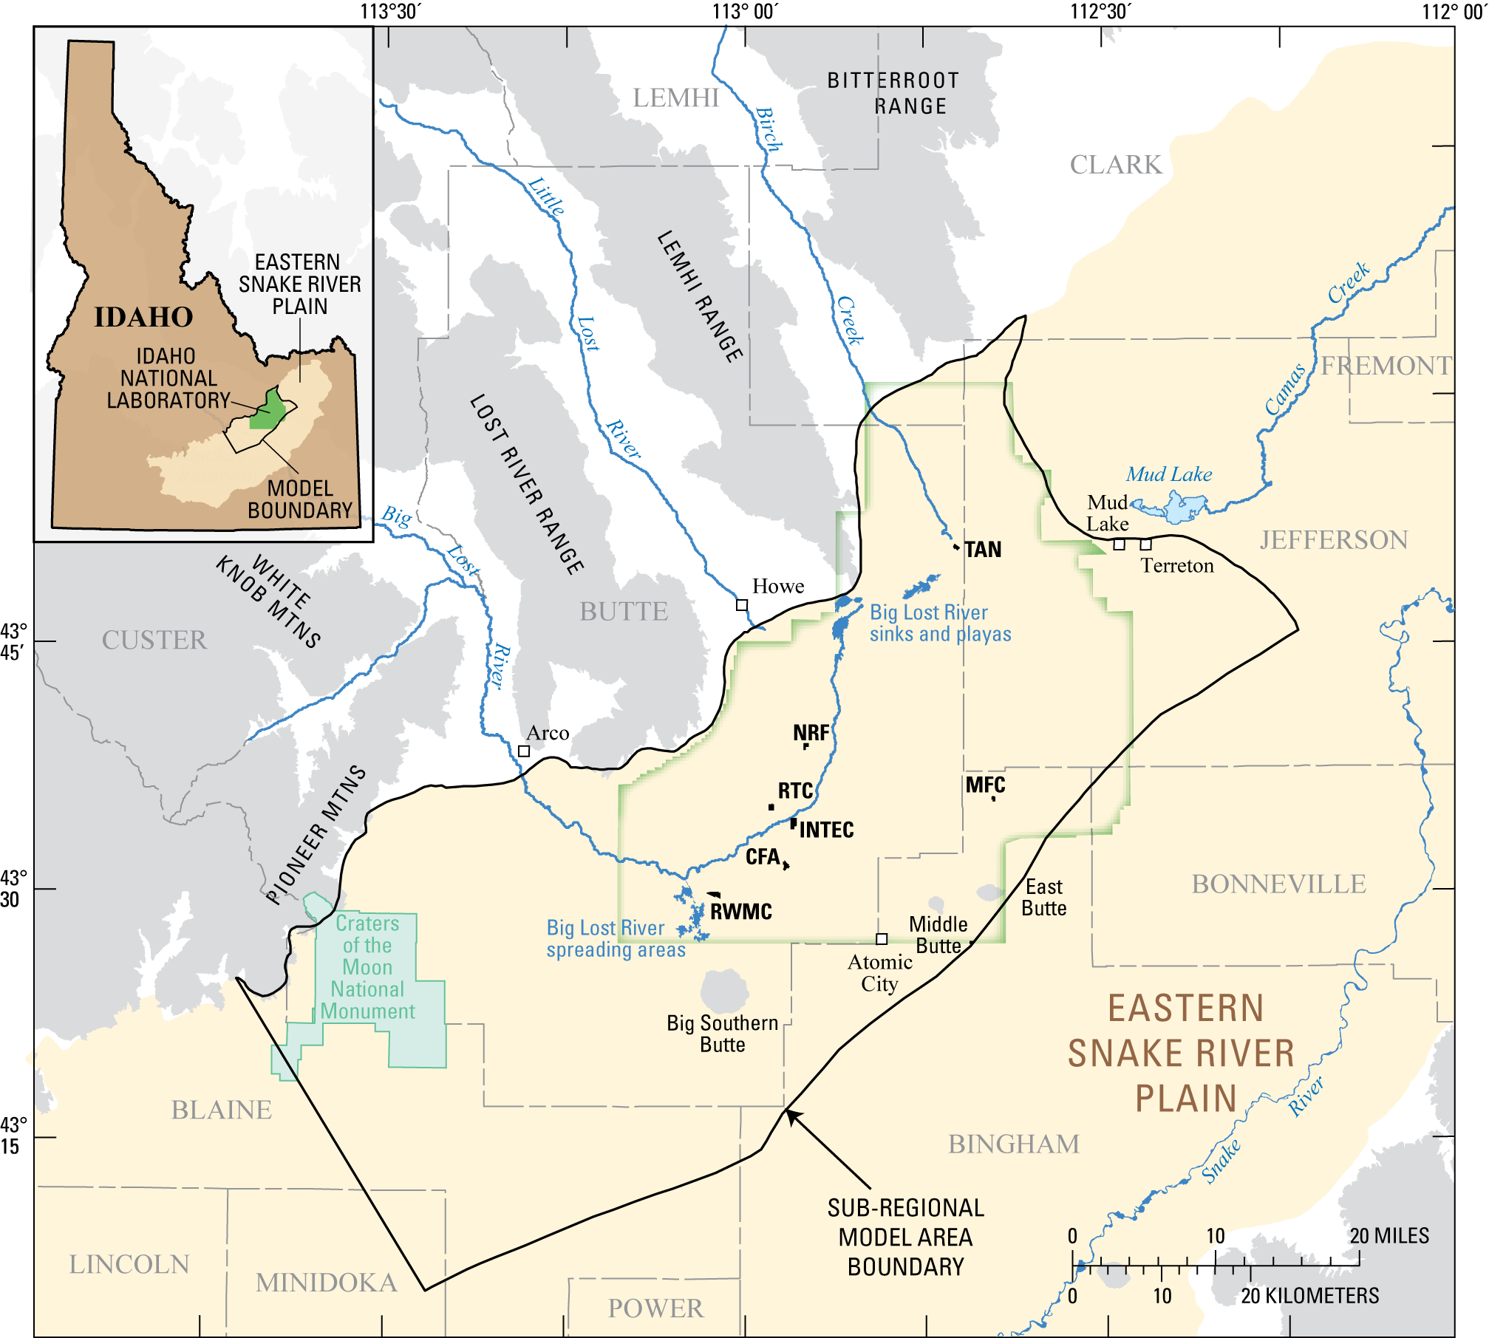
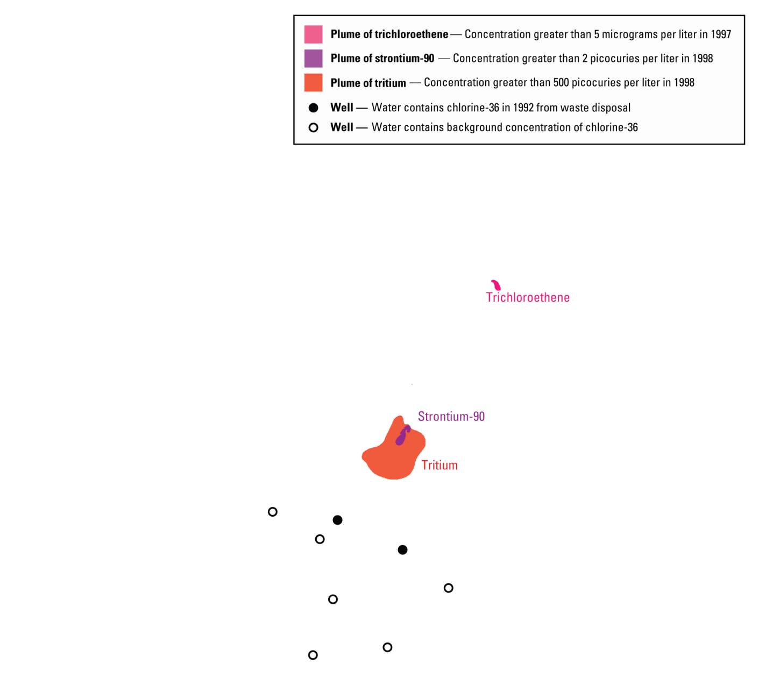
Notes:
-The sub-regional model area is located in the west-central part of the plain, covers approximately 2,000 square miles, and includes most of the Idaho National Laboratory.
-The INL was established in 1949 to build, operate, and test nuclear reactors. A 50-plus year history of waste disposal at the INL has resulted in measurable concentrations of contaminants in the aquifer beneath the INL.
-The principal sources of contaminants are wastewater-disposal sites at Test Area North (TAN), the Naval Reactors Facility (NRF), the Reactor Technology Complex (RTC), and the Idaho Nuclear Technology and Engineering Center (INTEC).
-[[NEXT]] The contaminants include trichloroethene (the pink plume), stronntium-90 (the purple plume), tritium (the red plume), and chlorine-36 which was detected in monitoring wells downgradient of RTC and INTEC. Note that little data is available to characterize the true areal extent and shape of these plumes. Also, it’s difficult to determine the long-term risks associated with contaminants that are present in the aquifer today or might be present in the future because of slow releases of residual contamination present in the unsaturated zone.

Slide 4
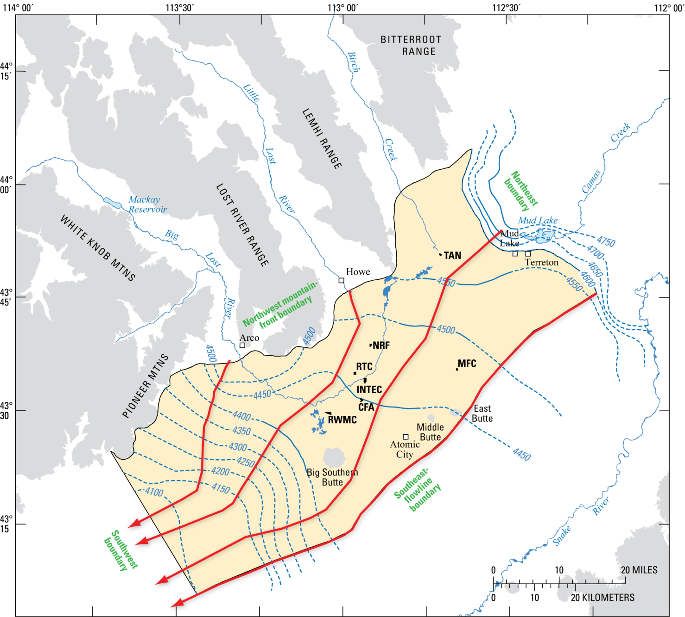
Notes:
-The model area is bounded on the northwest by mountain fronts and valley tributaries to the plain and on the southeast by an inferred regional groundwater flowline near the central axis of the plain. The northeast boundary is defined by a steep increase in the hydraulic gradient of the water table; whereas, the southwest boundary was selected to ensure that the model area would be sufficiently large to simulate contaminant movement beyond the farthest known extent of INL-derived contaminants in the aquifer.
-The vertical dimension of the model area is represented by the thickness of the saturated aquifer.

Slide 5
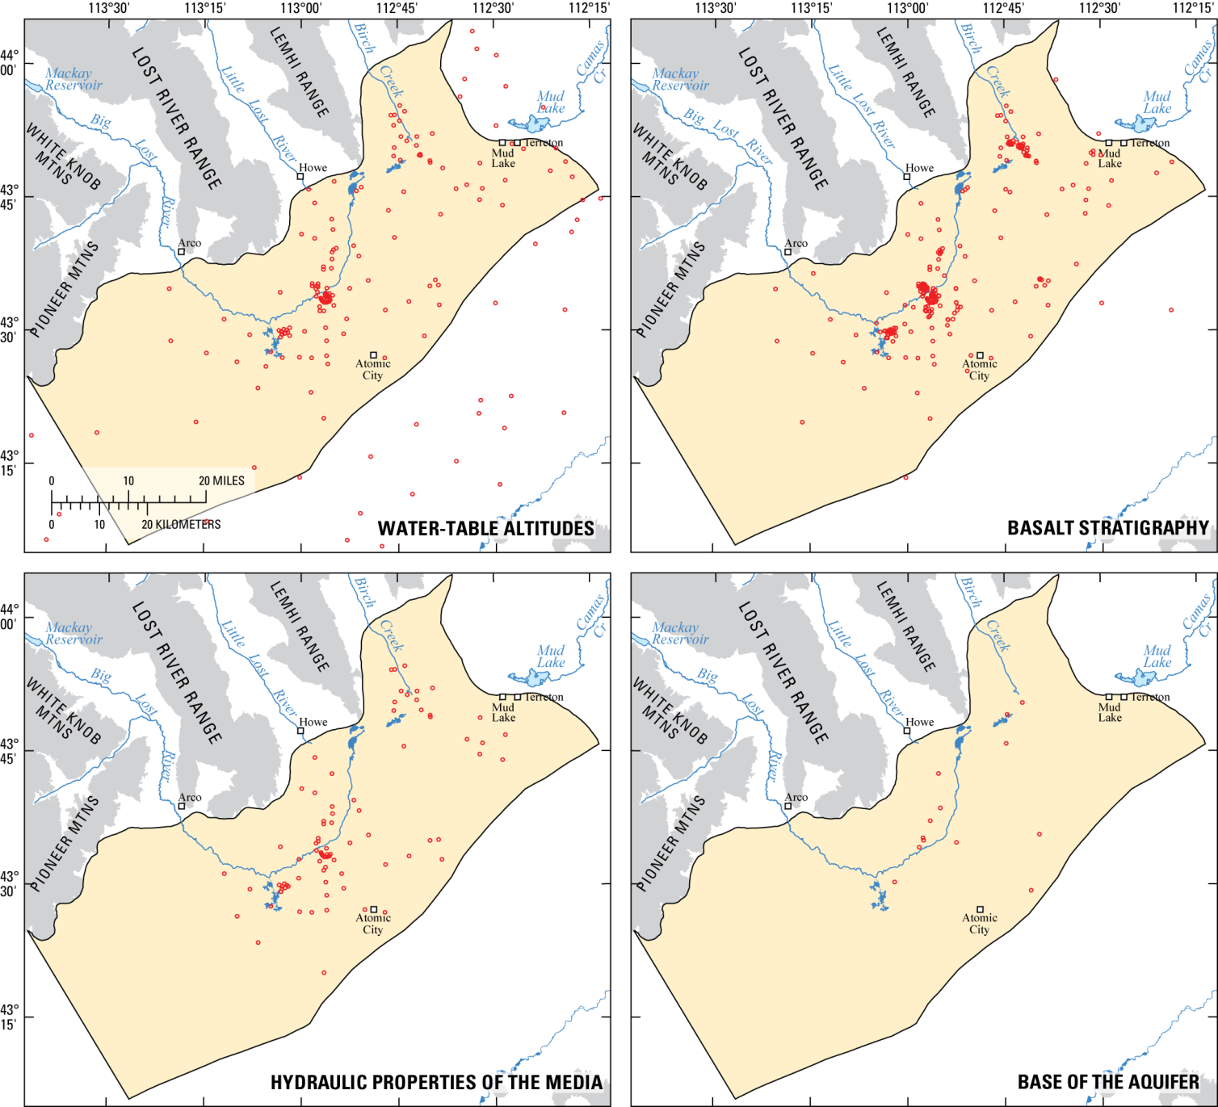
Notes:
-The data source for water-table altitudes, the basalt stratigraphy, hydraulic properties of the media, and the base of the aquifer comes from boreholes located within the aquifer (these are the open red circle symbols).
-For more than fifty years a network of monitoring wells has recorded water-level observations in over 100 boreholes with variable lengths of record. The distribution of boreholes is not, however, evenly distributed over the model area and little data exists to describe the hydrology of the aquifer in the vicinity of the downgradient boundary, as well as the Birch Creek area in the north. Most boreholes within the model area penetrate only the upper portion of the aquifer and are completed as open holes. Therefore, little data is available to describe the vertical distribution of hydraulic heads within the aquifer.
-Also keep in mind that very little drillhole data was available to describe the base of the aquifer.

Slide 6
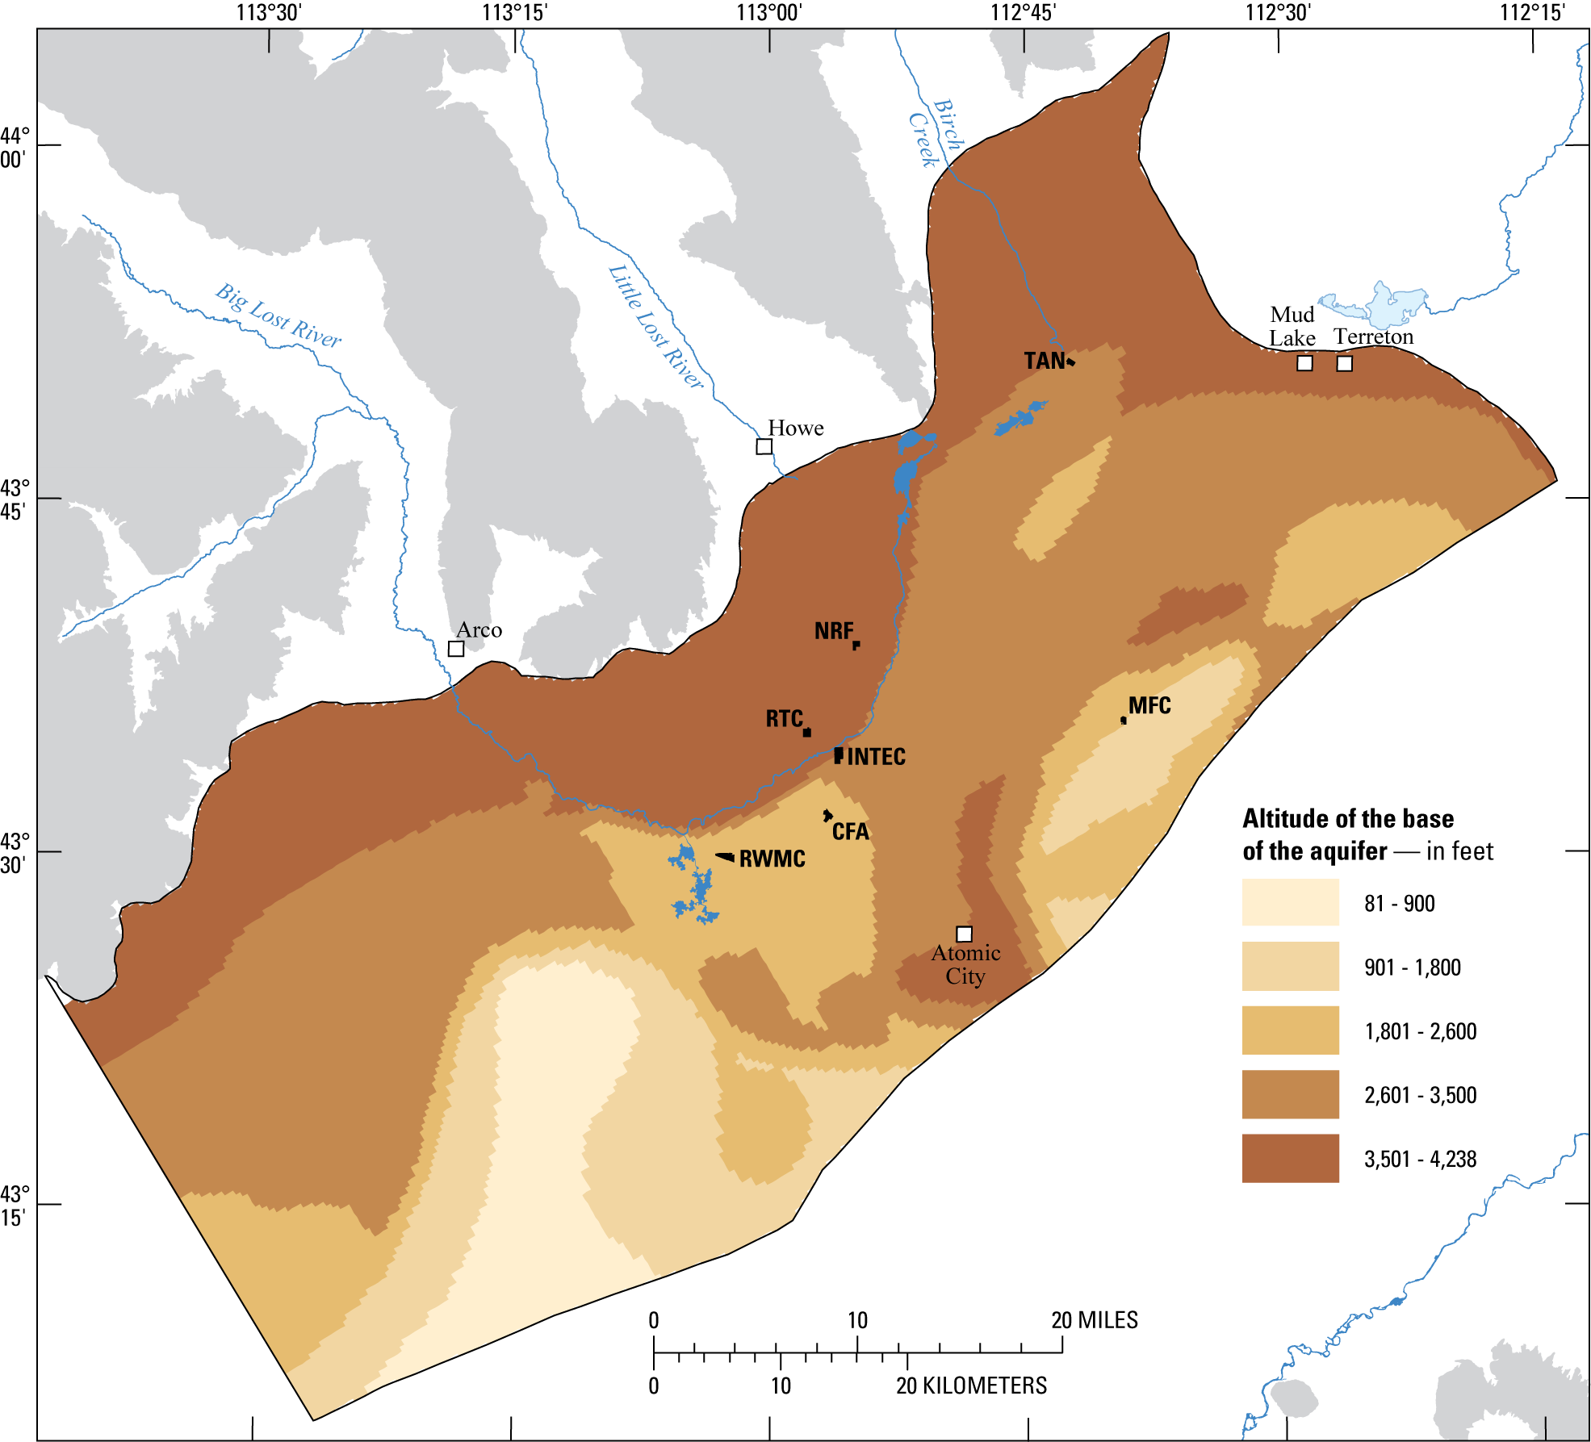
Notes:
-Luckily, surface-based electrical-resistivity surveys were available to estimate the altitude of the base of the aquifer. The saturated aquifer is at least 1,200 feet thick and may be 4,000 feet thick in the southern part of the model area.

Slide 7
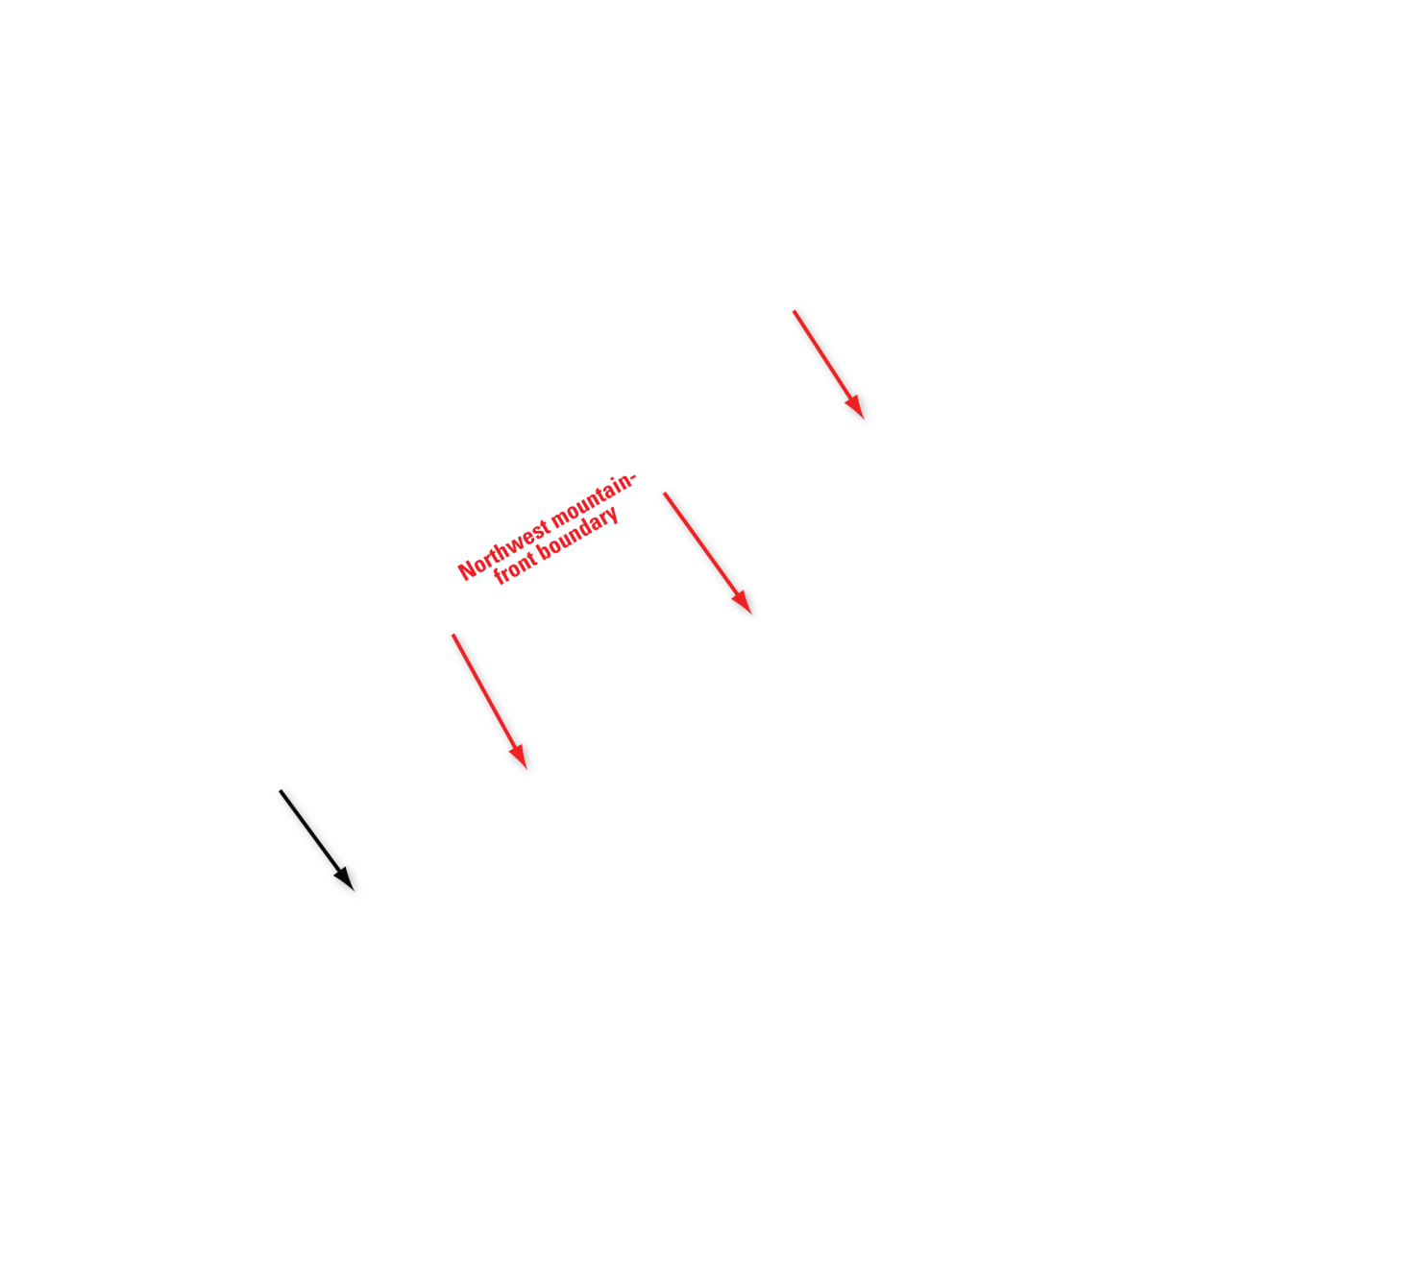
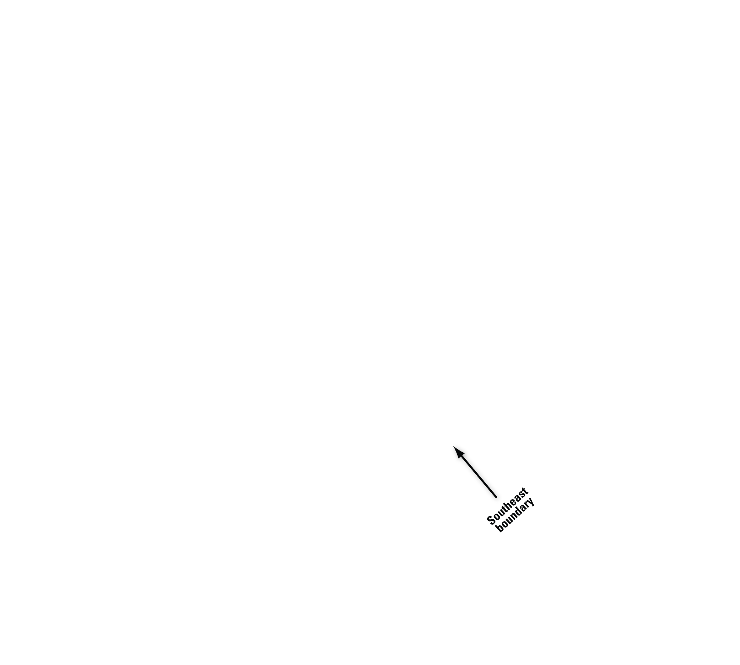
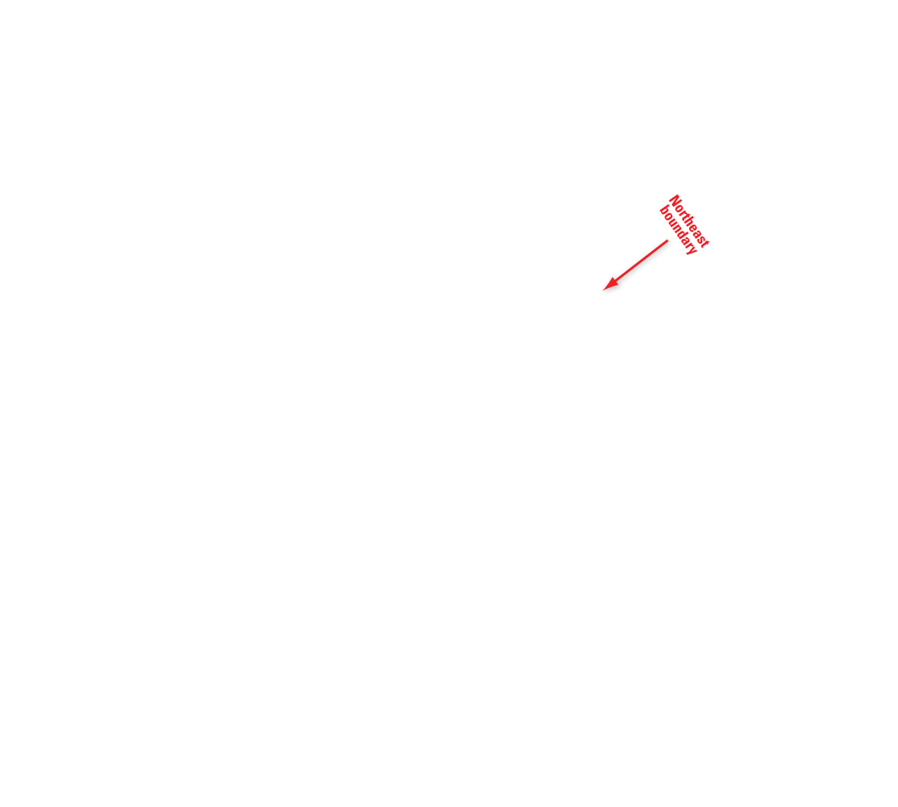

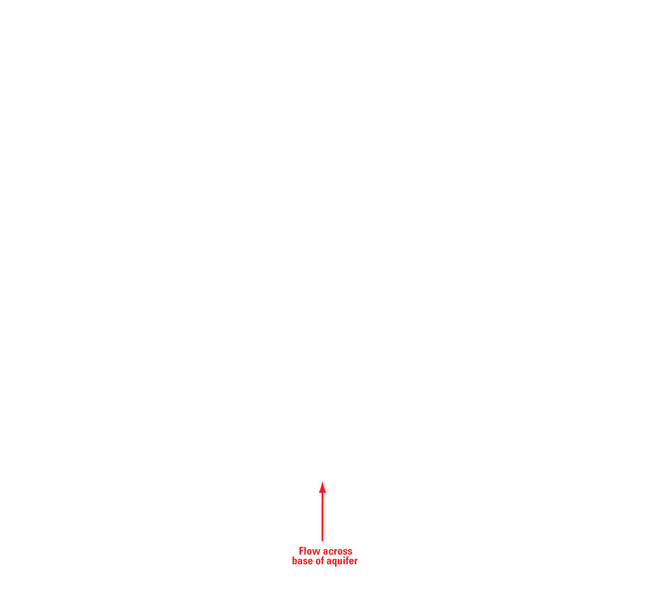
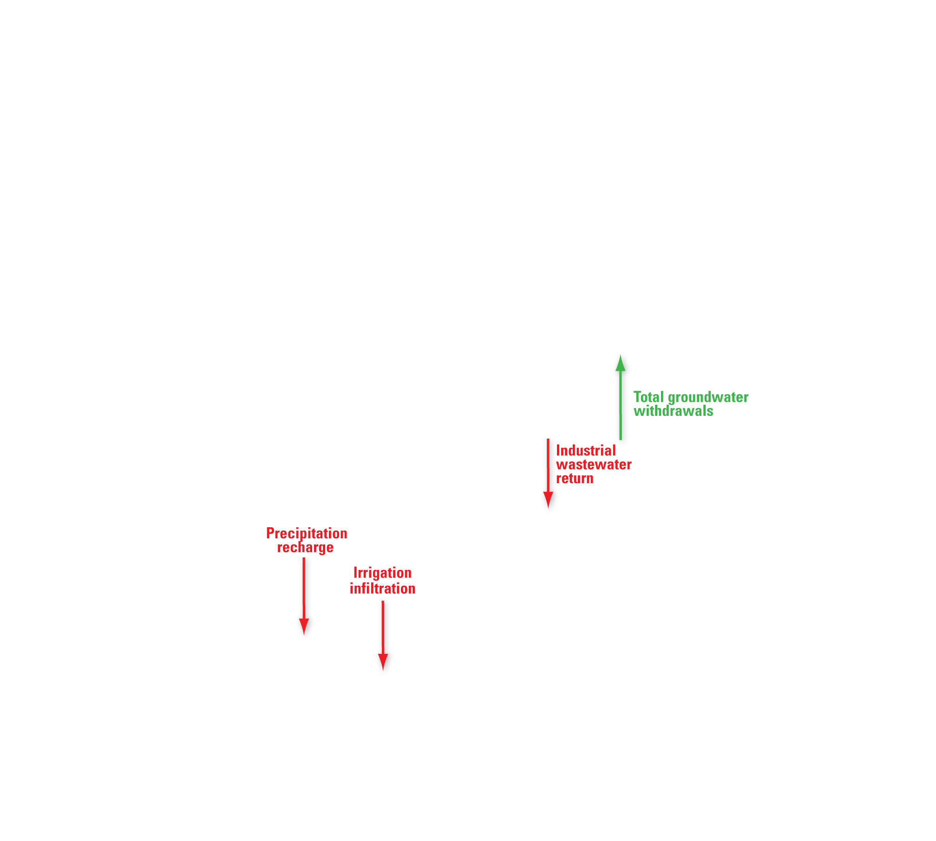
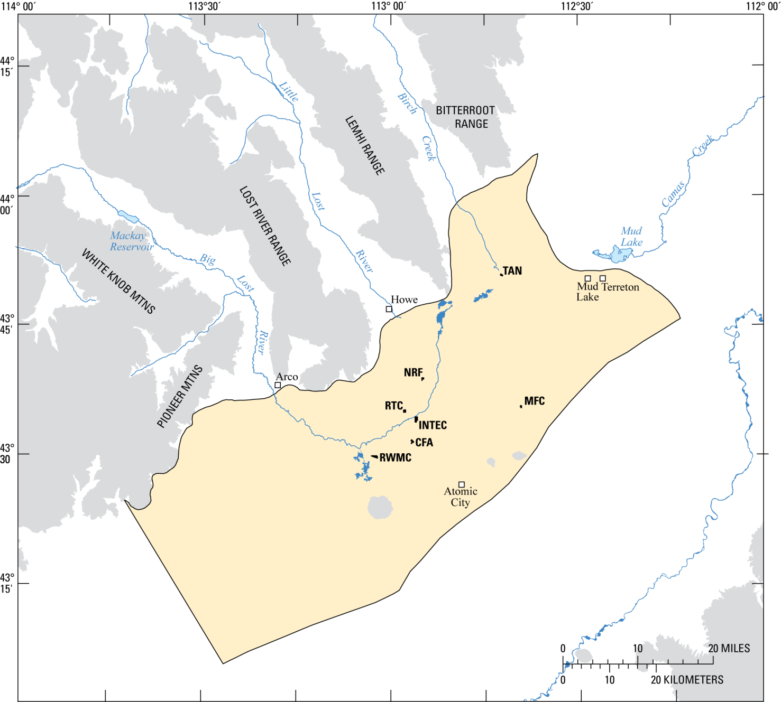
Notes:
-Let us now consider the surface water and groundwater fluxes across the boundaries of the model domain.
-[[NEXT]] Along the northwest mountain-front boundary, surface water and underflow enters the system from three tributary valleys (the Big Lost River, Little Lost River, and Birch Creek). The Big Lost River has the greatest volumetric flux and flux along the mountain fronts was assumed negligible.
-[[NEXT]] The southeast boundary is based on the inferred regional groundwater flowline so it’s assumed that there is no flux across this boundary.
-[[NEXT]] The northeast boundary has the largest component of underflow into the aquifer and no surface water component.
-[[NEXT]] The southwest boundary is also represented as underflow with no surface water component.
-[[NEXT]] Flow across the base of the aquifer is quite small,
-[[NEXT]] and fluxes across the water-table boundary consist of precipitation recharge, irrigation infiltration, industrial wastewater return and total groundwater withdrawals.

Slide 8
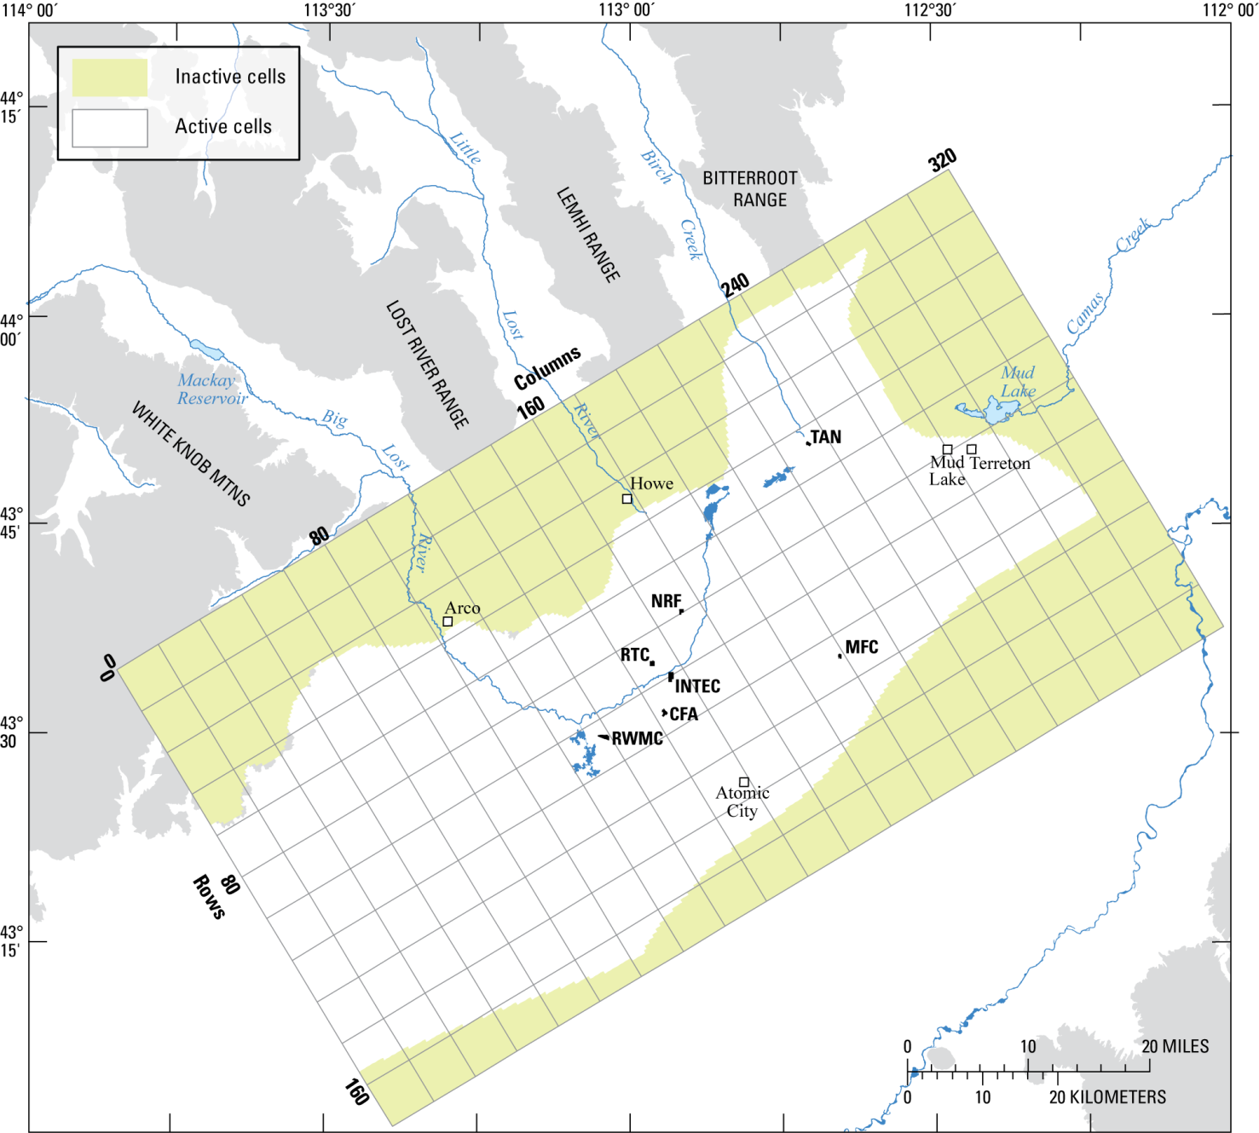
Notes:
-The numerical model used to simulate groundwater flow is MODFLOW 2000.
-The spatial disretization of the finite-difference grid within the aerial dimension has 320 columns and 176 rows with a grid spacing of a quarter mile by a quarter mile.
-Active and inactive cells are used to define the models spatial domain.

Slide 9
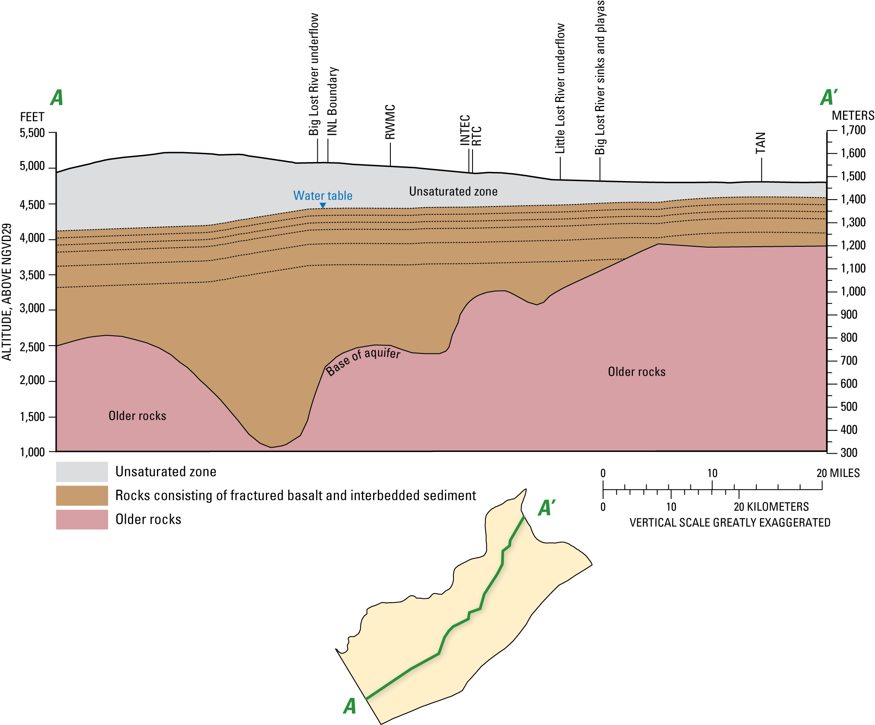
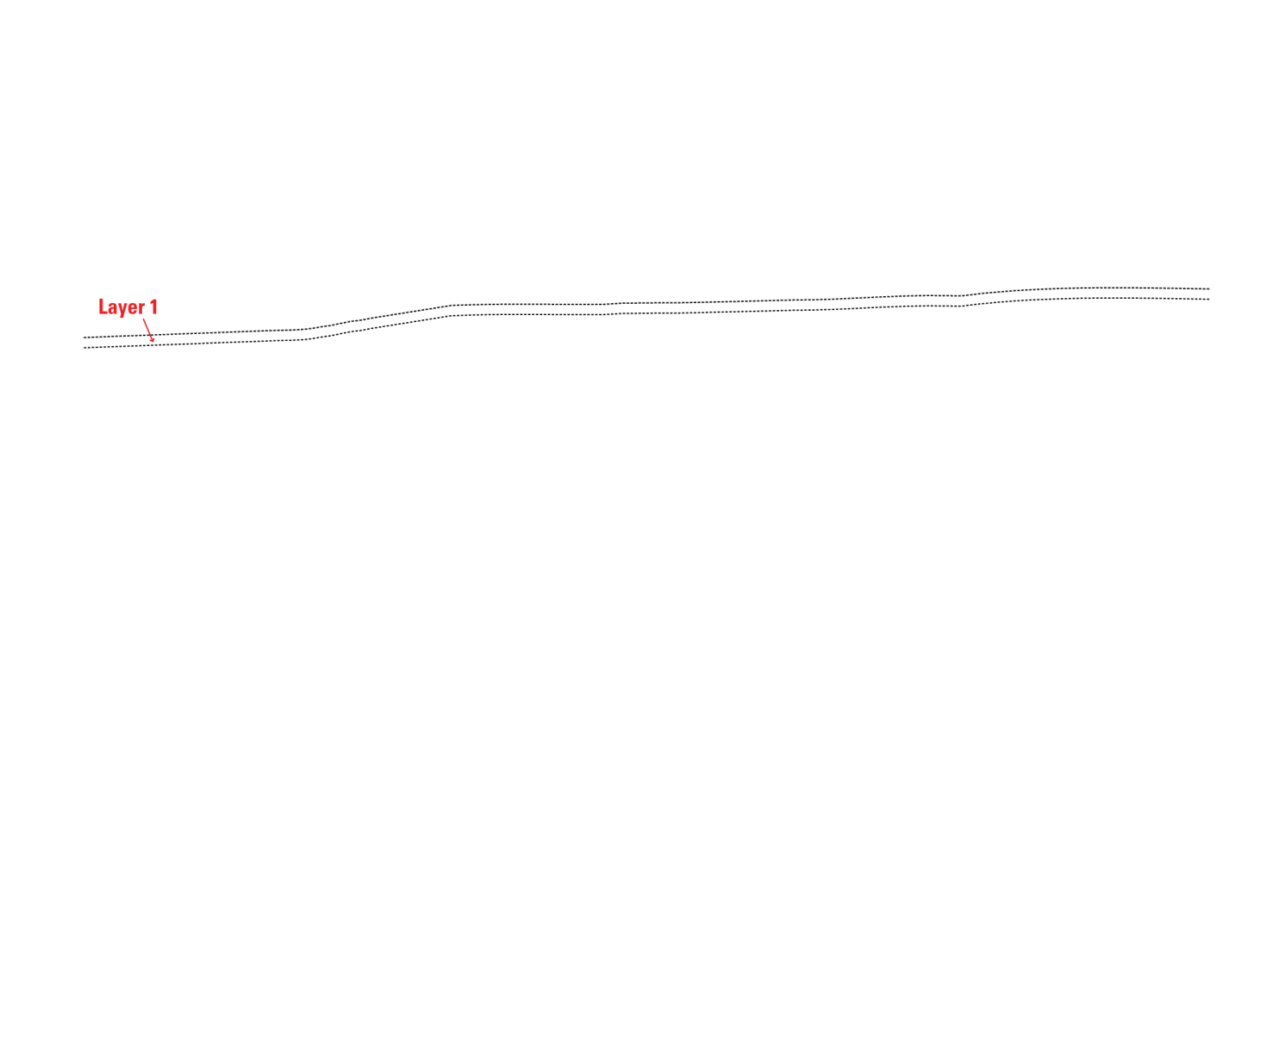
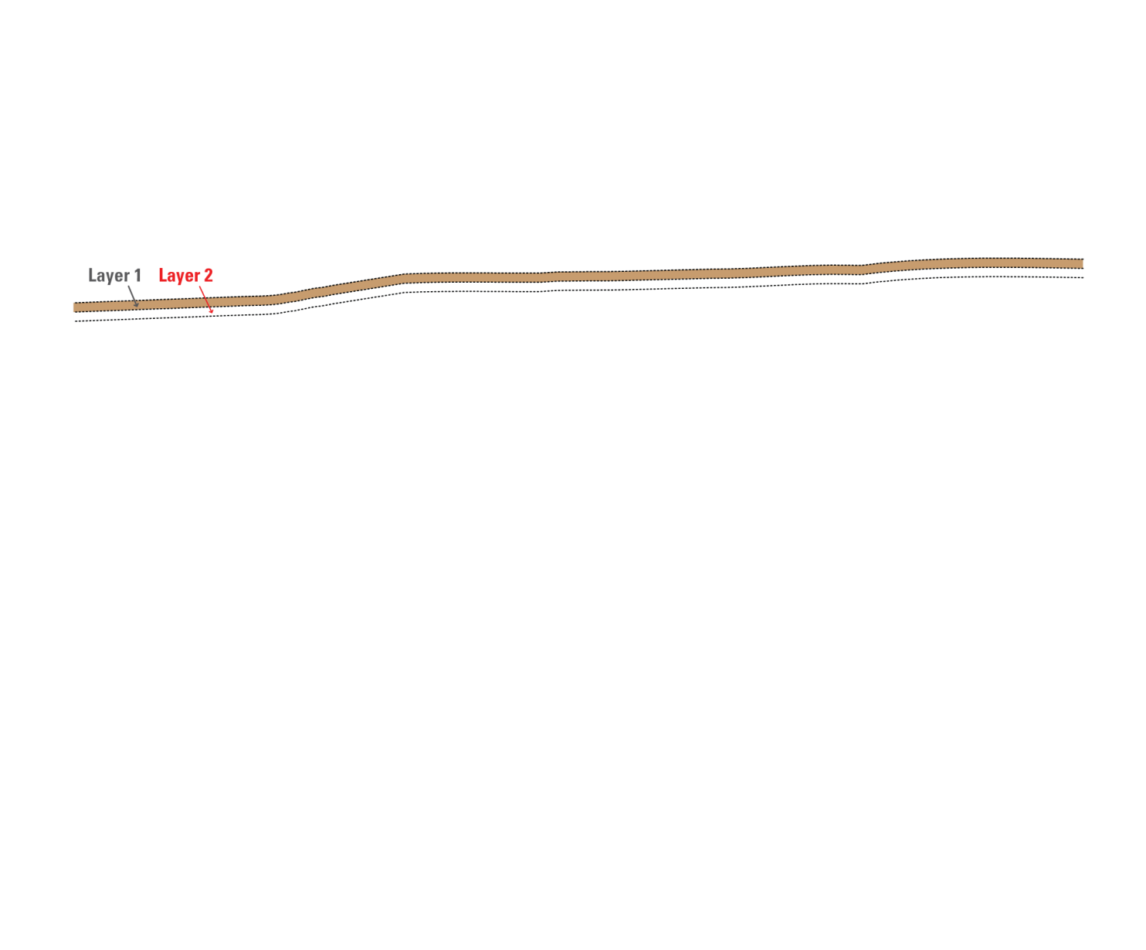
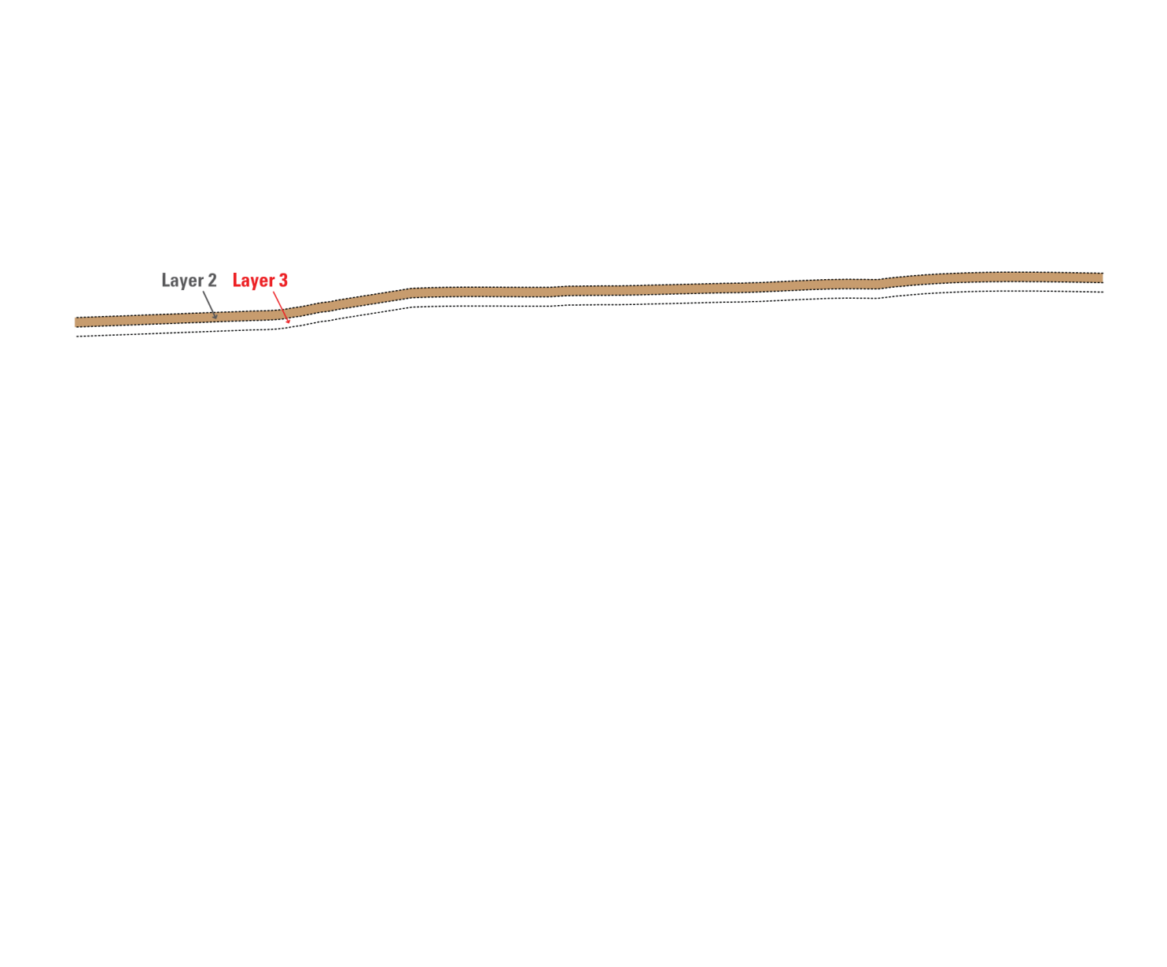
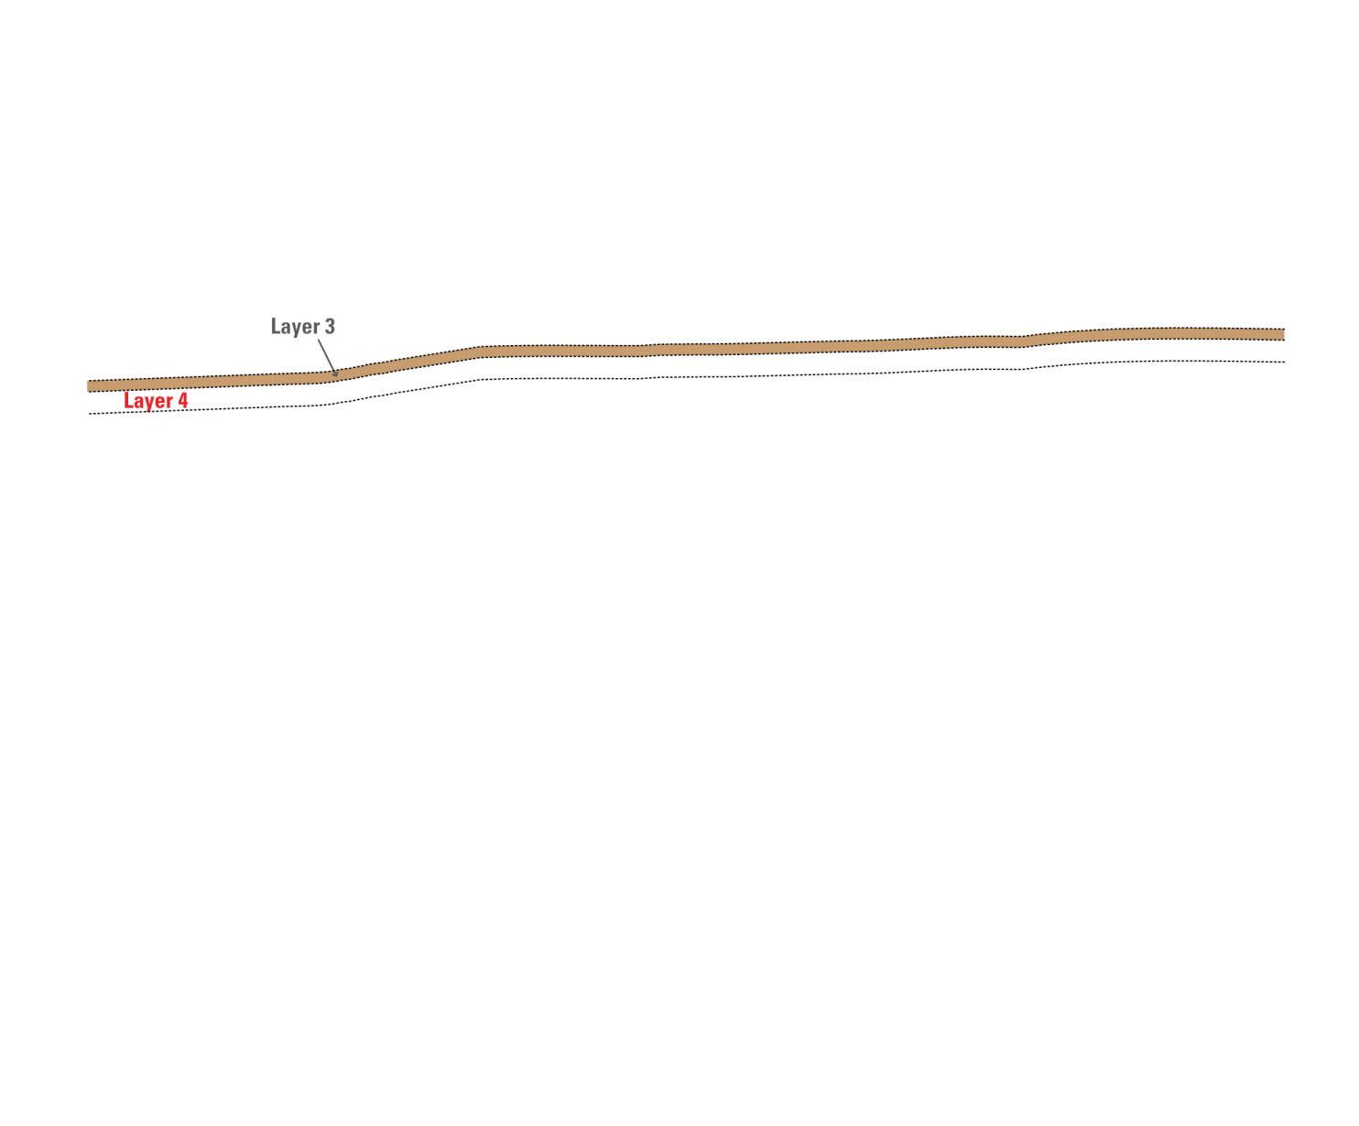
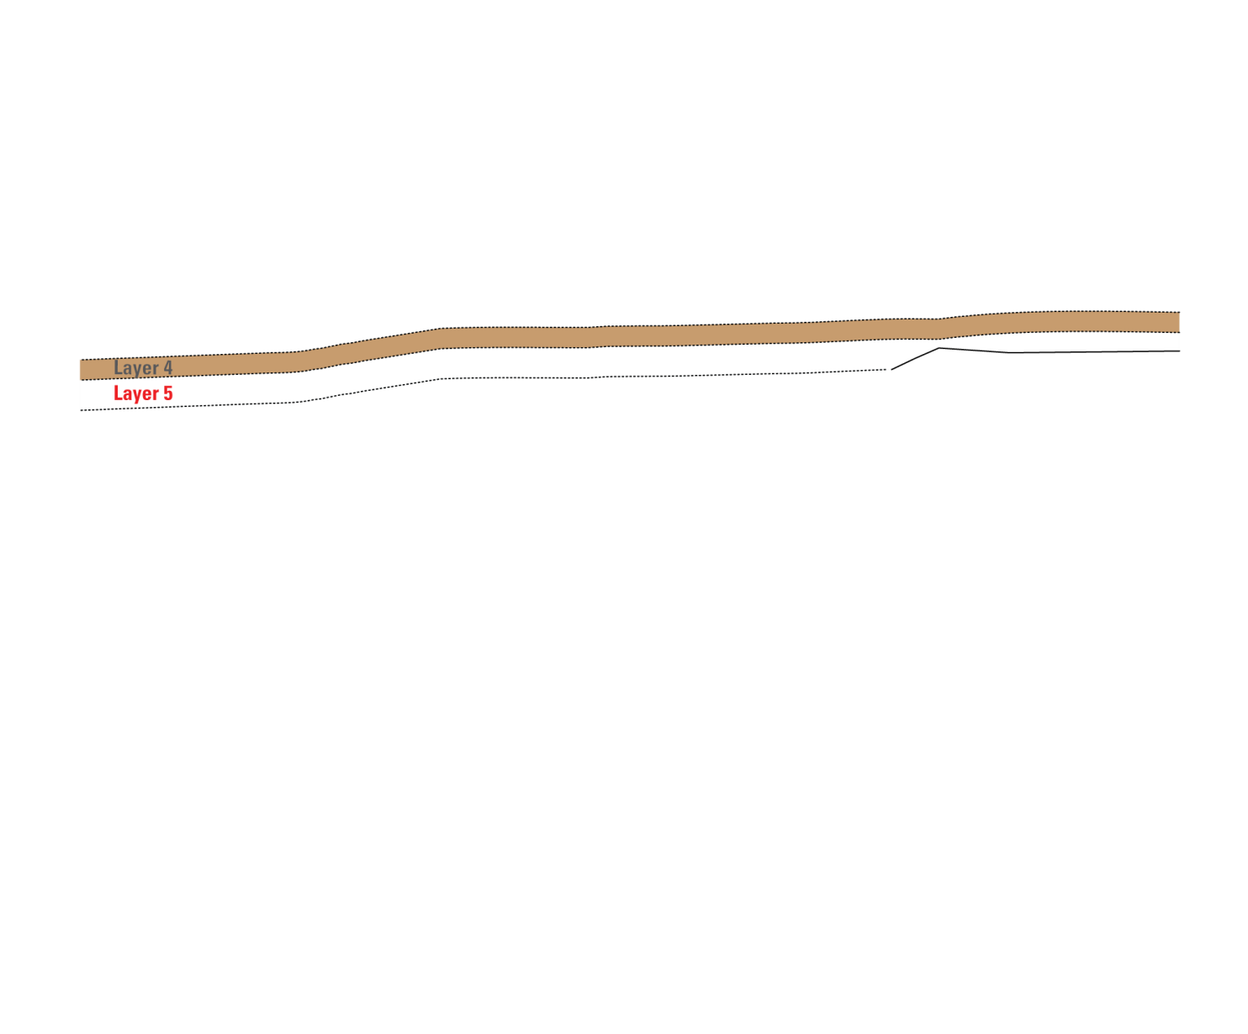
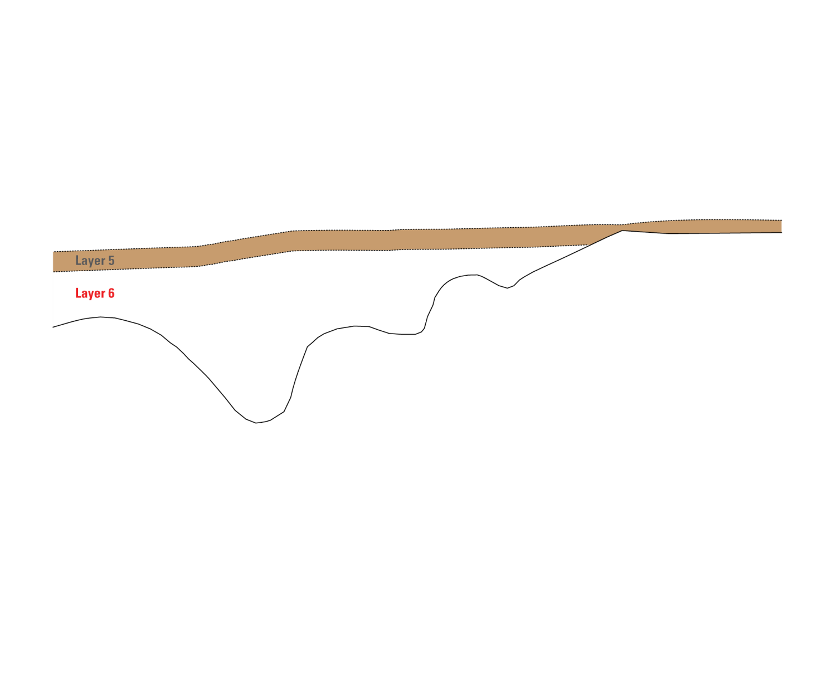
Notes:
-The finite-difference grid is extended into the vertical dimension using layers of cells. The vertical grid spacing consists of six layers of varying thickness:
-[[NEXT]] Layer 1 is approximately 100 feet thick, depending on the water-table altitude;
-[[NEXT]] Layer 2 is 100 feet thick;
-[[NEXT]] Layer 3 is 0 to 100 feet thick;
-[[NEXT]] Layer 4 is 0 to 200 feet thick;
-[[NEXT]] Layer 5 is 0 to 300 feet thick; and
-[[NEXT]] Layer 6 is 0 to about thirty-three hundred feet thick and extends down to the base of the aquifer.

Slide 10
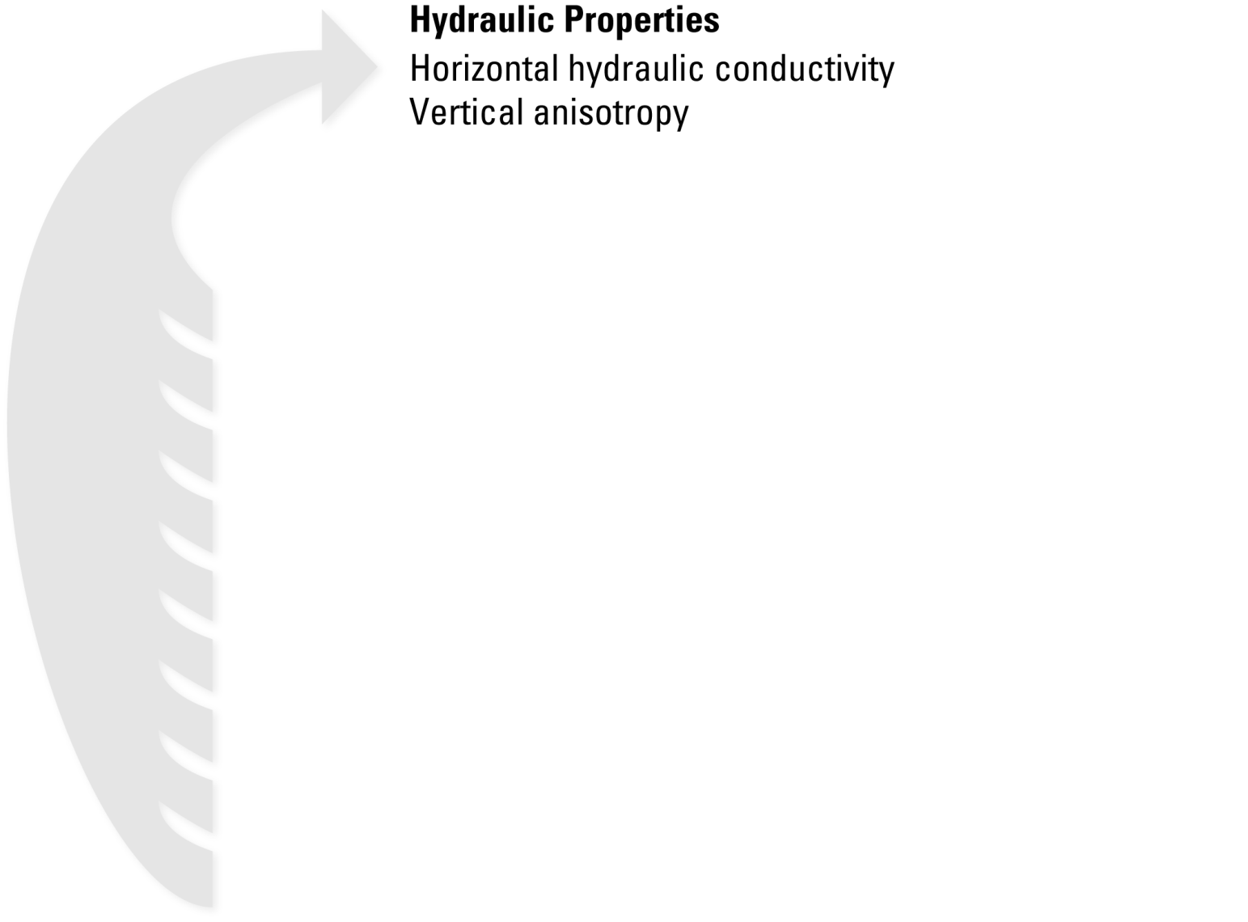
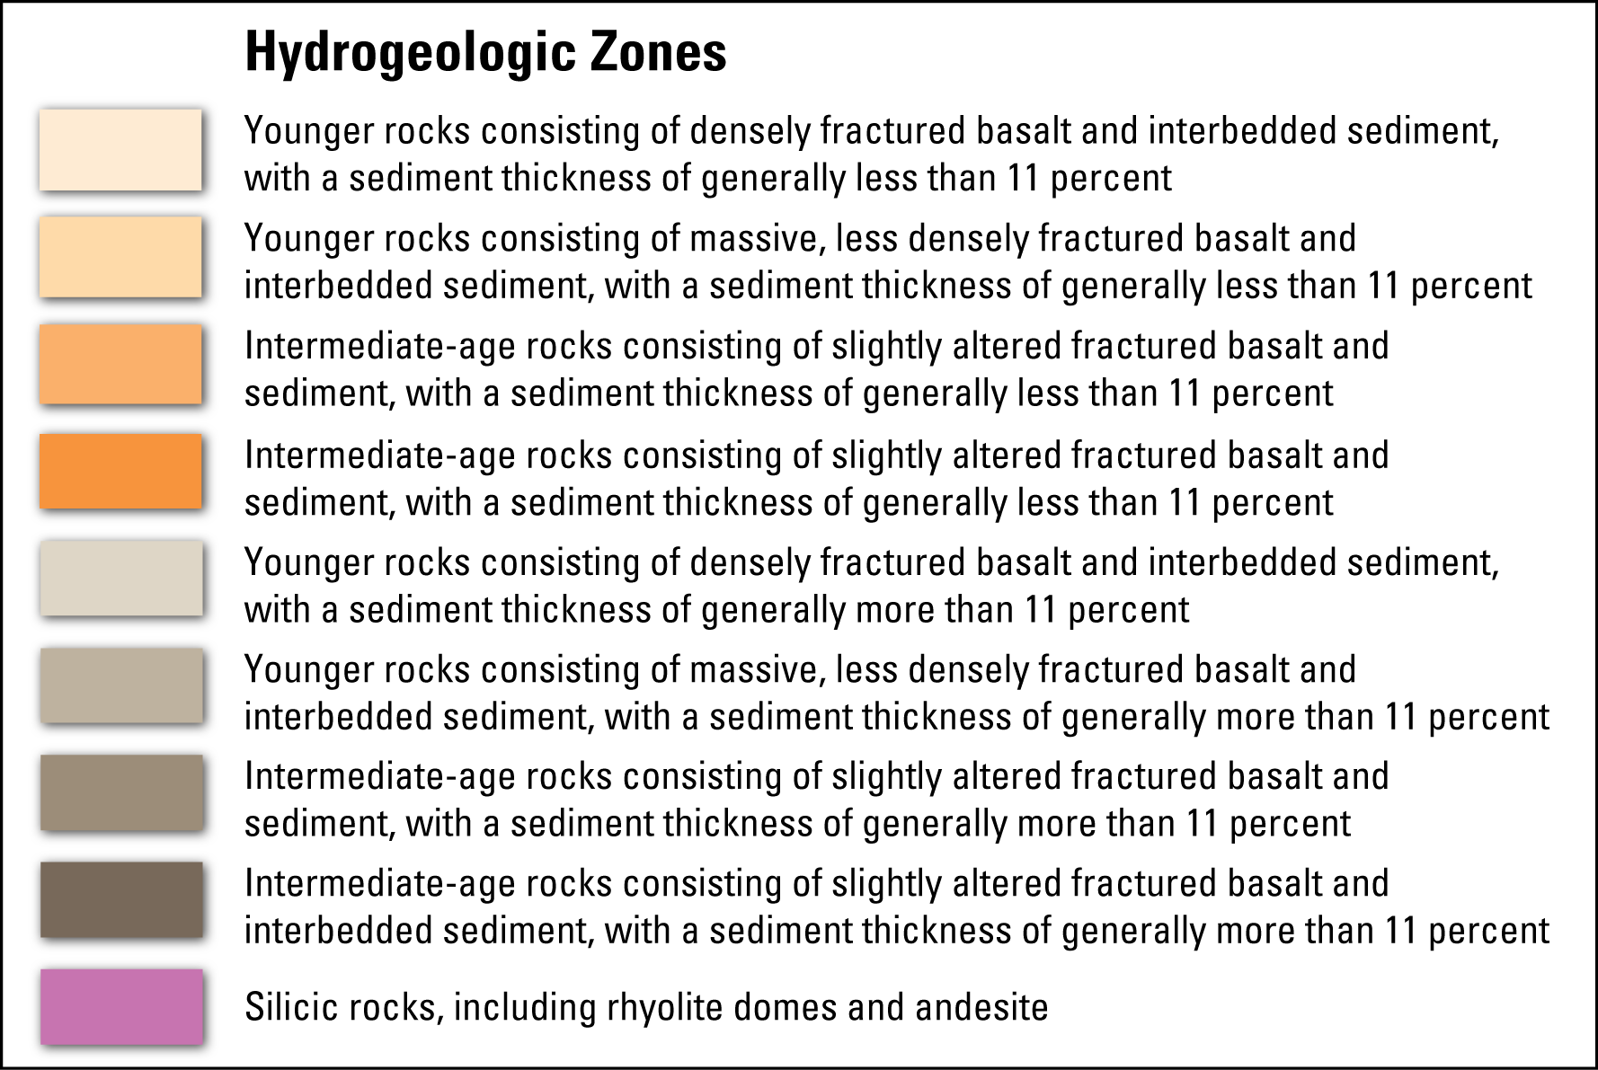
Notes:
-The complex basalt stratigraphy of the aquifer was simplified using homogeneous and anisotropic hydrogeologic zones.
-There are a total of 9 hydrogeologic zones within the model. [[NEXT]] Specified for each zone are hydraulic properties that include the horizontal hydraulic conductivity and the vertical anisotropy.

Slide 11
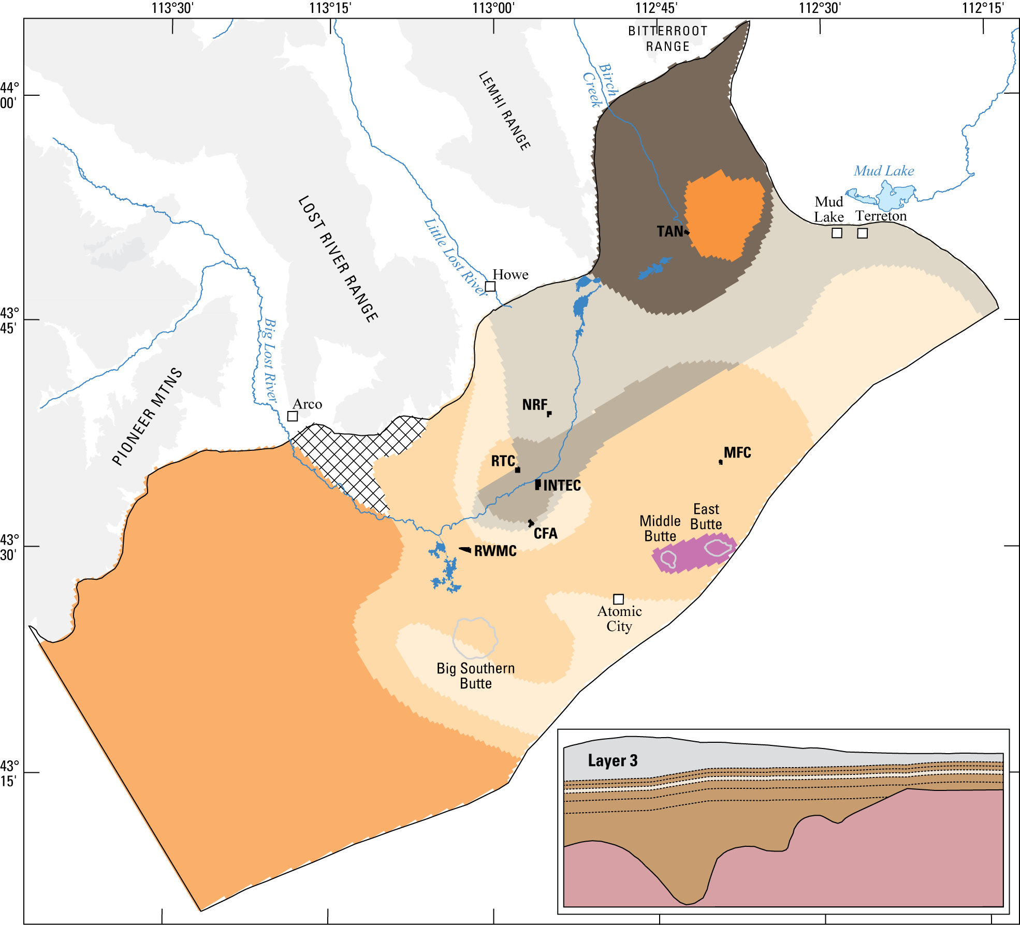
Notes:
-The hydrogeologic zones within layer 3 are shown here and should provide you with a sense of how zones were allocated within a model layer.
-Inactive cells are represented with hatching and show, in this case, the encroachment of older rocks from the Lost River Range.
-Note that most of the more transmissive zones are captured in the top three layers.

Slide 12
Flow Models
Steady-state
Simulates 1980 conditions
Average 1966-1980 streamflow infiltration for the Big Lost River, the major variable inflow to the system
Transient
Simulates 1980-1995 conditions
Includes a 5-year wet cycle (1982-1986) followed by a 8-year dry cycle (1987-1994)
Tri-annual stress periods
Initial conditions taken from steady-state simulation
Notes:
-The steady-state flow model simulates 1980 conditions and average 1966-80 streamflow infiltration from the Big Lost River, the major variable inflow to the system.
-The transient flow model simulates 1980-95 conditions and includes a 5-year wet cycle followed by a 8-year dry cycle. The model uses tri-annual stress periods with initial conditions taken from the results of the steady-state model.

Slide 13
Parameter Estimation
Steady-state Calibration
Horizontal hydraulic conductivity (K_{x}) for 7 of the 9 hydrogeologic zones
230 ≤ K_{x} ≤ 11,700 feet per day
A single global value for the vertical anisotropy (VANI)
VANI = 14,800
Transient Calibration
Specific yield (SY) for 5 of the 7 hydrogeologic zones within Layer 1
0.072 ≤ SY ≤ 0.115
Notes:
-Parameter estimation was used to approximate the hydraulic properties of the hydrogeologic zones using measurement observations and the accuracy associated with these measurements.
-For steady-state model calibration the horizontal hydraulic conductivity for 7 of the 9 zones were estimated. The conductivity for the other two zones were fixed. Estimated values of conductivity ranged from 230 to 11,700 feet per day and were all within acceptable ranges reported in the literature for similar rock types. A single global value for the vertical anisotropy was estimated at 14,800; a value which was much higher than expected. However, recall that there is very little observed vertical head data to assist with its estimation.
-For calibration of the transient model, specific yield was estimated for 5 of the 7 zones within layer 1.
-So, how do model simulations compare with field observations?

Slide 14
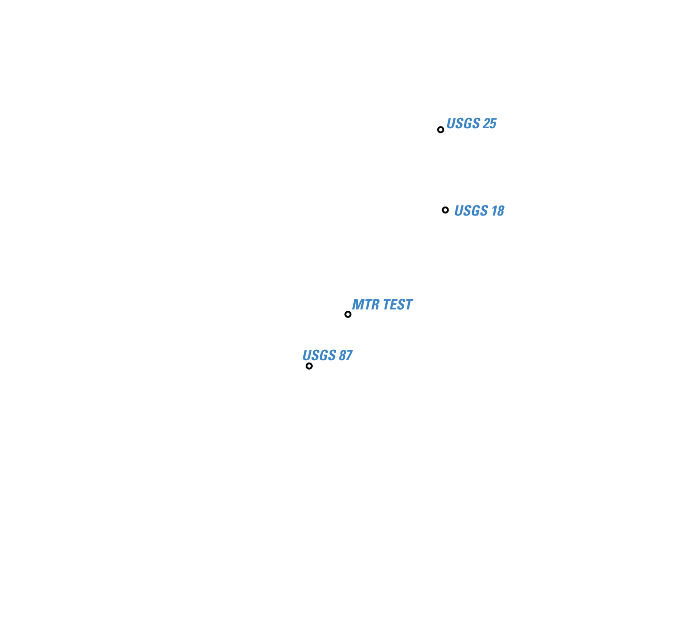
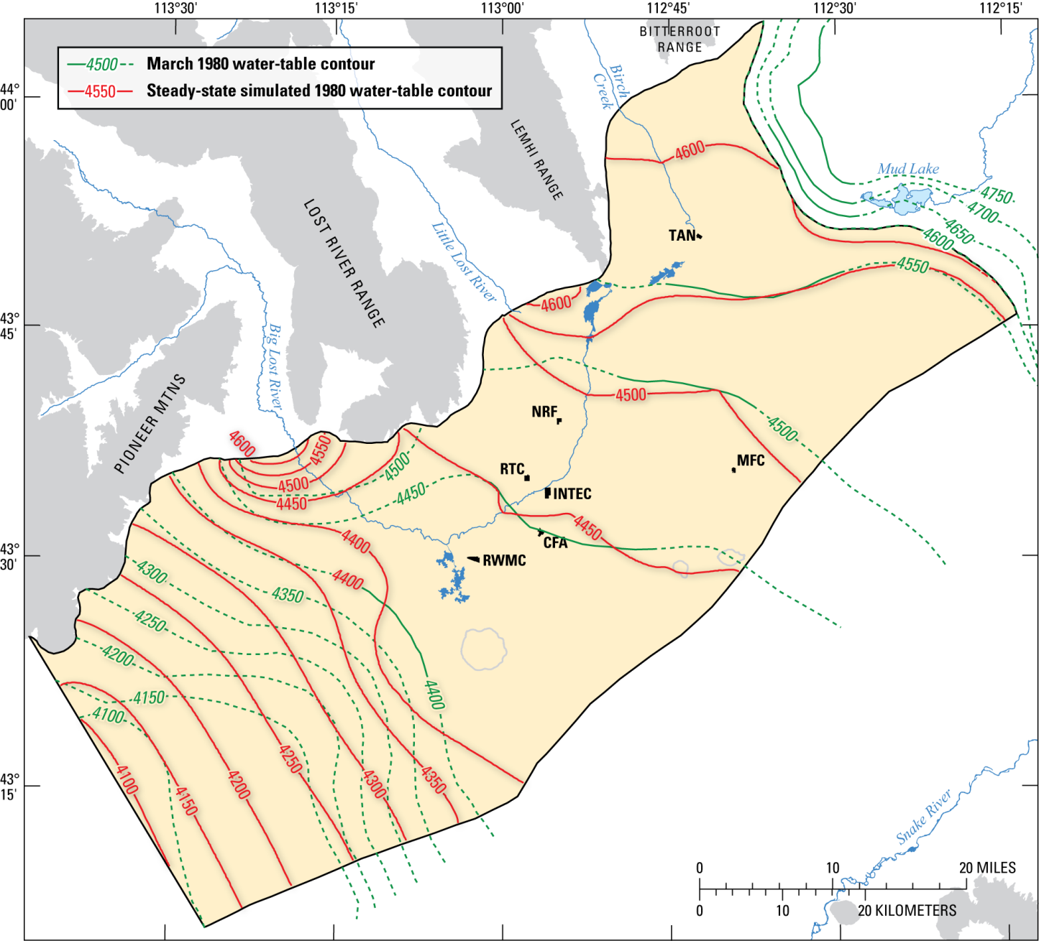
Notes:
-The following is a comparison between the 1980 observed water-table contours (shown in green) and the steady-state simulated water-table contours (shown in red). As you can see, model-fit was quite good through most of the upper and central regions and poor in the southeast and Birch Creek regions, where field data was limited or unavailable. Basically, where there were field observations to constrain the parameter estimation routine the model-fit was good and where there was sparse observational data model-fit was poor.
-For the transient model we looked at how well the model simulated observed water-levels within the following monitoring wells [[NEXT]] USGS 25, USGS 18, MTR Test, and USGS 87.

Slide 15
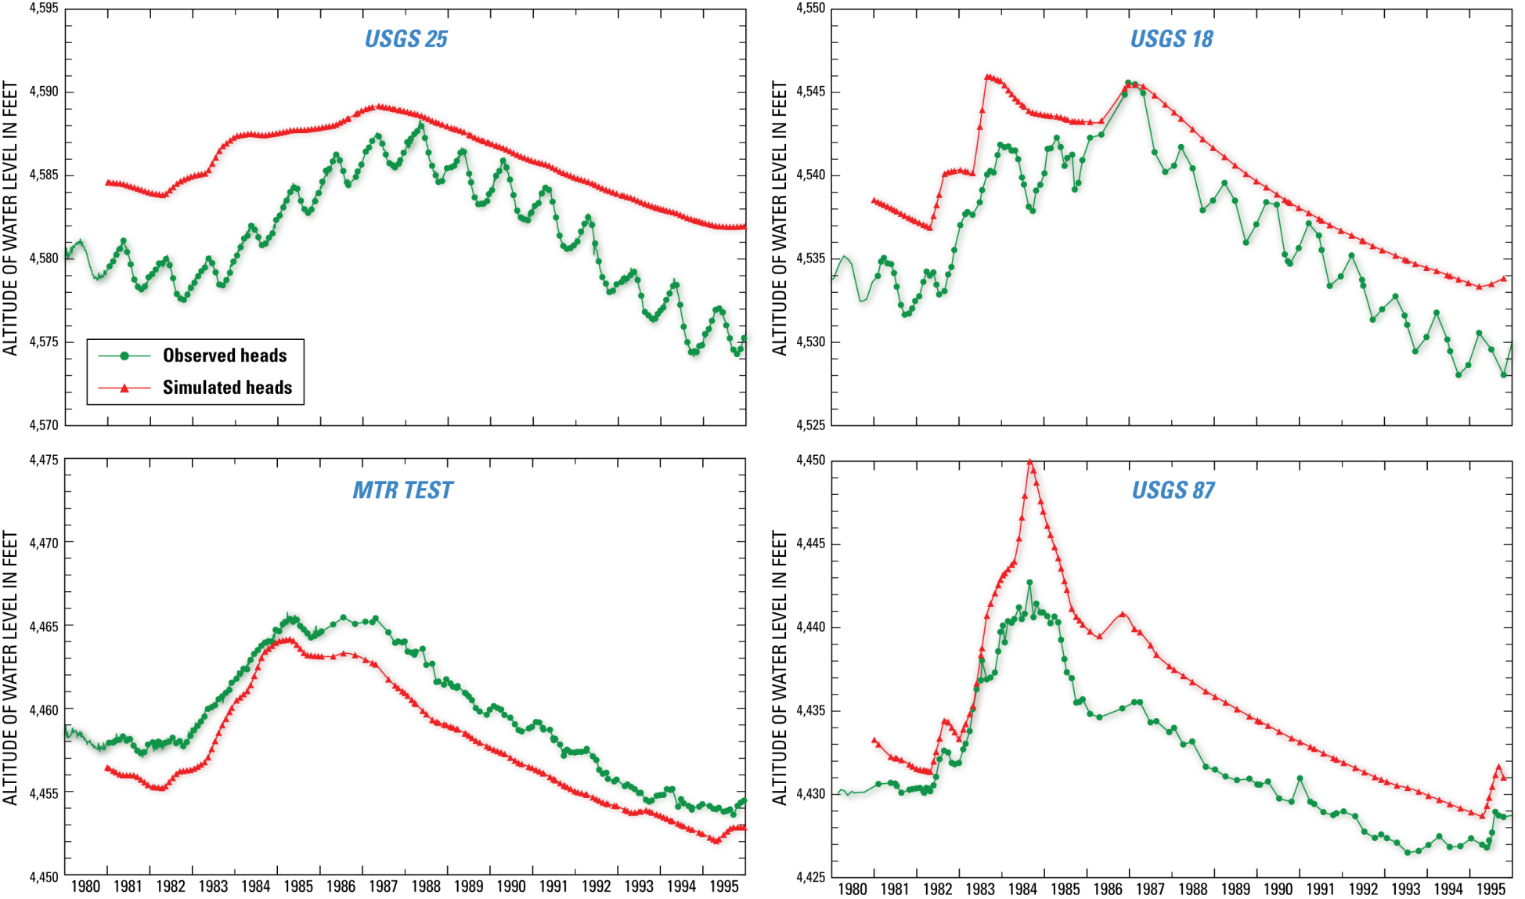
Notes:
-Here the vertical axis gives the altitude of the water level in feet, and the horizontal axis in time, ranging from 1980 to 1995. The green line shows the observed heads and the red line simulated heads. As we can see, the model was able to reasonably reproduce the observed fluctuations in all four monitoring wells. This is quite good considering that hydraulic conductivities for the transient model were based on values determined from the steady-state model calibration.

Slide 16
Particle Tracking
Computes paths and time of travel for imaginary “particles” of water moving through the simulated flow field. Used to simulate 1953-1968 advective transport of tritium originating from the INTEC and RTC.
Steady-state flow model simulates 1980 conditions
Transient flow model reconfigured to simulate 1953-1968 conditions
Wastewater disposal
Production well pumpage
Big Lost River infiltration
Notes:
-Particle tracking was also used to evaluate model-fit. Particles were introduced into the steady-state and transient flow fields to simulate 1953-68 advective transport of tritium originating from the INTEC and RTC.
-Note that the transient flow model was reconfigured to simulate 1953-68 conditions by altering model input to account for the historic record of wastewater disposal, production well pumpage, and infiltration from the Big Lost River.

Slide 17
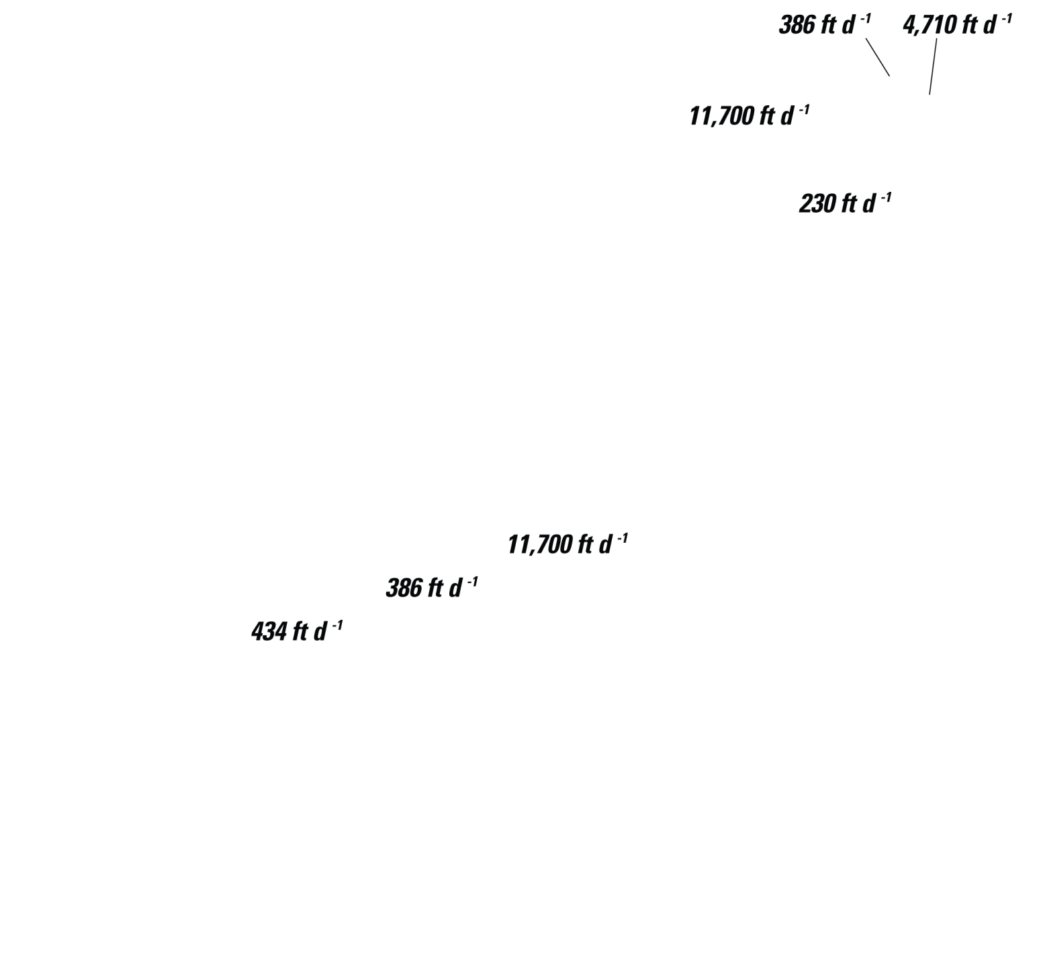
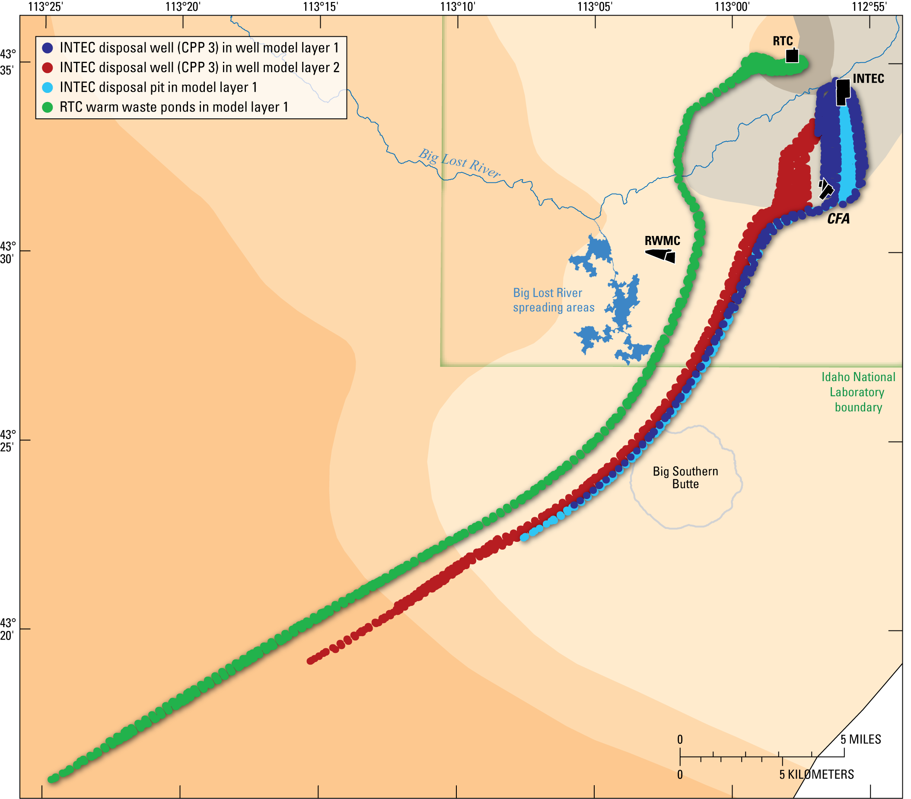
Notes:
-In both the steady-state and transient particle path simulations, particles were introduced at four different locations. These include the disposal well at INTEC including both model layers 1 and 2, the disposal pit at INTEC in model layer 1, and the RTC warm-waste ponds in model layer 1. The timing for particle releases was based on the historic records of tritium releases at these sites.
-Particles released into the steady-state flow field are shown here. In the background are the hydrogeologic zones within layer 1. [[NEXT]] If we take a look at the horizontal hydraulic conductivity for each of these zones we see that particle movement is based on the path of least resistance.
-For example, particles released from the RTC are drawn towards the zone of greatest conductivity and take the shortest downgradient path to get their. These particles then attempt to stay in the high conductivity zone for as long as possible while adhering to the regional flow direction.
-INTEC particles behave in a similar fashion. They too are drawn towards a high conductivity zone and exhibit increased spreading while traveling through a low conductivity zone. Refraction of the particles along the boundary of the two zones, moving from a low conductivity zone to a high conductivity zone, results in a narrowing of the plume and a deviation in its direction.

Slide 18

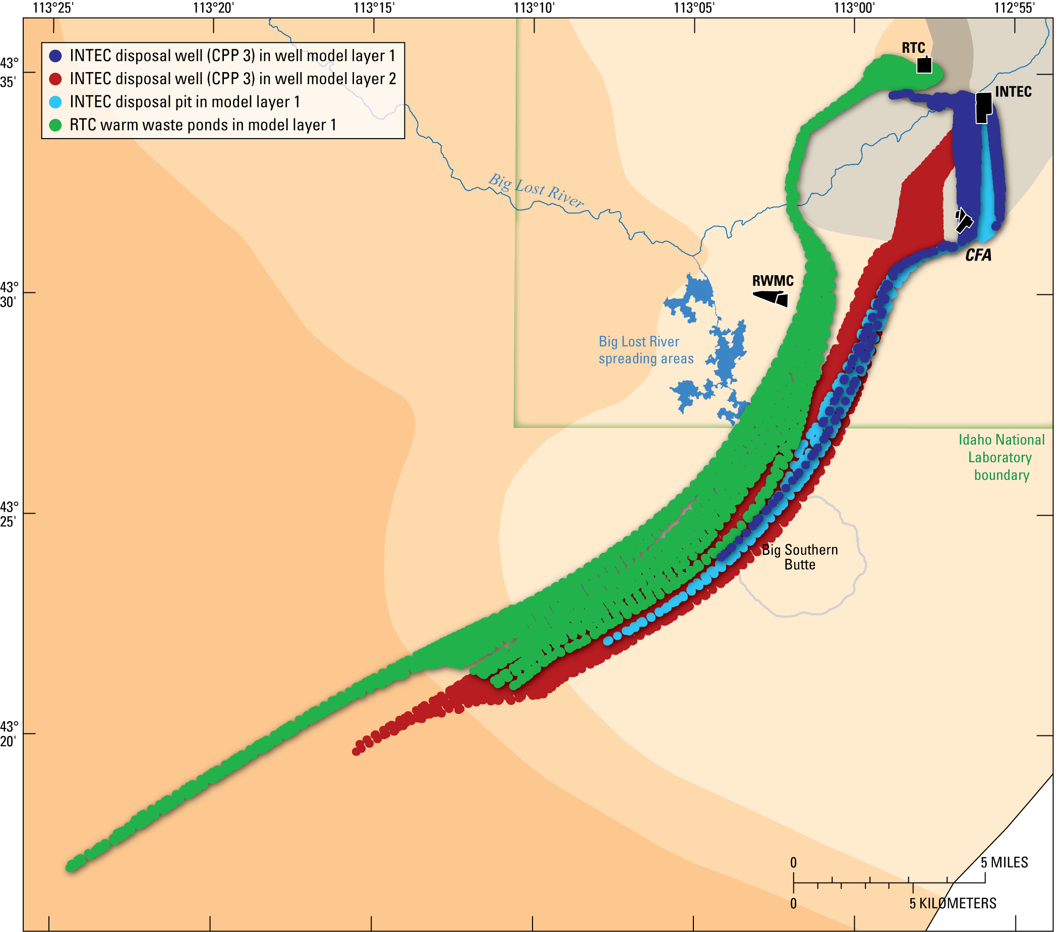
Notes:
-Particles released in the transient flow field show much more aerial spreading. Temporal changes in the local hydraulic gradient can account for some of the observed dispersion of contaminants in the aquifer near the major sources of contamination and perhaps the majority of the observed dispersion several miles downgradient of the facilities.
-Let us now add-in the steady-state particle paths for comparison purposes [[NEXT]]. The increase in particle spreading should now be obvious.

Slide 19
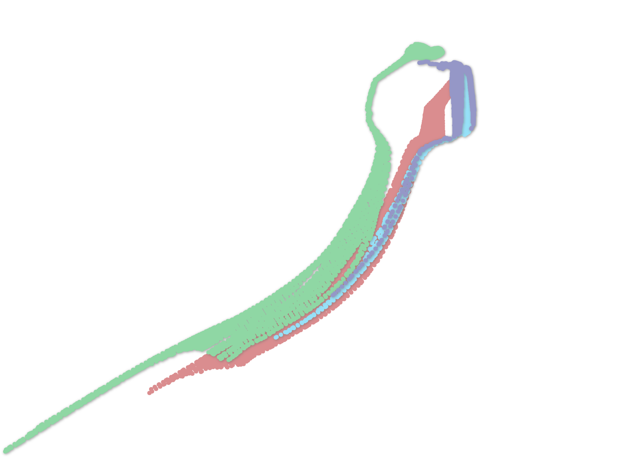
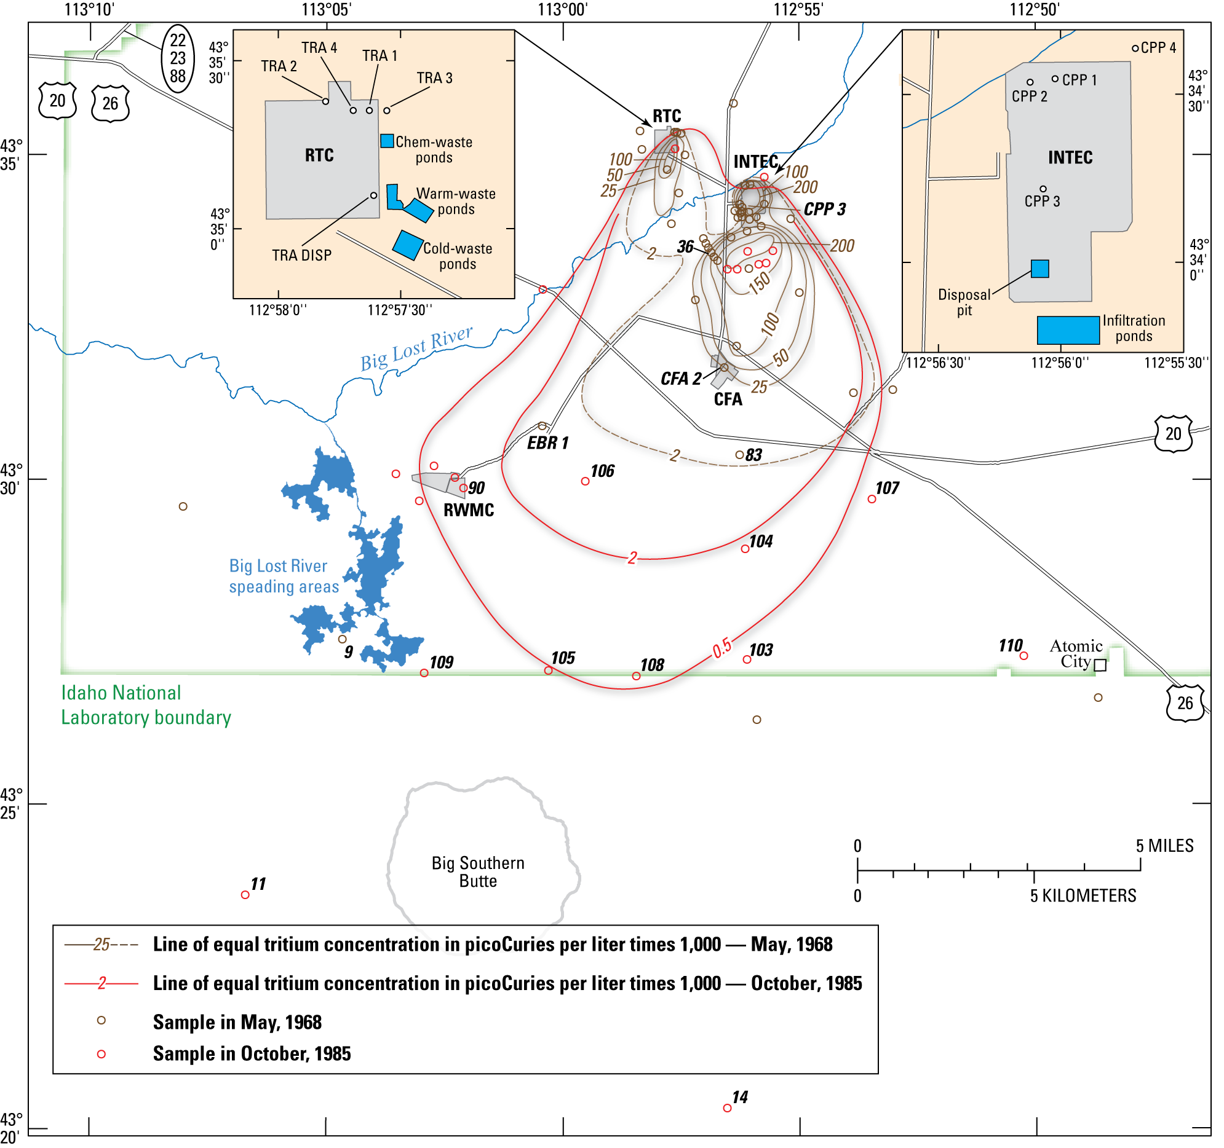
Notes:
-Estimates of the areal extent and shape of the observed tritium plumes based on 1968 and 1985 sampling events are shown here. Note that the 1968 tritium detection limits were somewhat high and very little data was available to characterize the true shape and areal extent of the plume.
-[[NEXT]] If we add-in the transient particle paths we can see that the distance downgradient of the INTEC that simulated particle plumes were able to reasonably reproduce the shape and dimensions of the 1968 tritium plume extended only about 4 mi downgradient.

Slide 20

Conclusions
Analysis of simulations shows that flow is:
Dominantly horizontal
Temporally variable
Analysis of particle tracking shows:
Flow paths and velocities are influenced by the large contrasts in hydraulic properties of the media
Temporal changes in the water table can account for observed contaminant dispersion
Simulated particle plumes were able to reasonably reproduce the 1968 tritium plume (< 4 mi from source)
Notes:
-In conclusion, the analysis of the flow simulations show that flow is dominantly horizontal due to the high vertical anisotropy, and temporally variable due to streamflow infiltration from the Big Lost River.
-Analysis of the particle tracking shows: flow paths and velocities are influenced by the large contrasts in the hydraulic properties of the media (specifically the differences in hydraulic conductivity); temporal changes in the water table can account for some of the observed dispersion of contaminants in the aquifer near the major sources of contamination and perhaps the majority of the observed dispersion several miles downgradient; and simulated particle plumes were able to reasonably reproduce the 1968 tritium plume. Although the shape and extent of the particle plumes appear much different from observed plumes at distances greater than 4 miles.

Slide 21
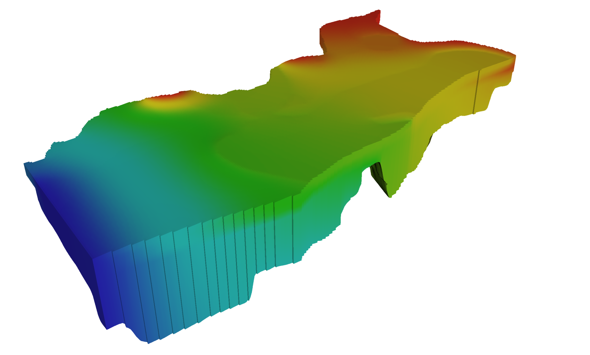
Questions
Notes:
-Are there any questions?

Slide 22
